Slide 1
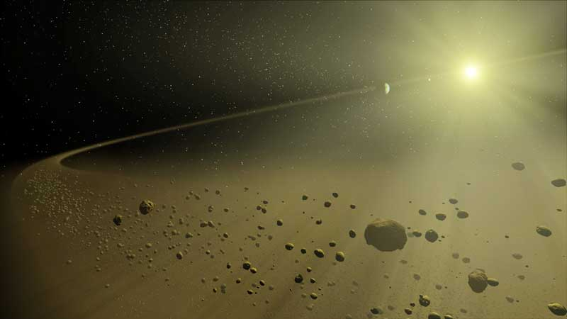
Solar System formation and evolution
Alessandro Morbidelli (OCA, Nice)
Work done in 10years in collaboration with: W. Bottke, B. Bitsch, R. Brasser, A. Crida, R. Gomes, S. Jacobson, H. Levison, S. Marchi, F. Masset, D. O’brien, S. Raymond, K. Tsiganis, K. Walsh
HELMHOLTZ ALLIANCE: Planetary Evolution and Life

Slide 2
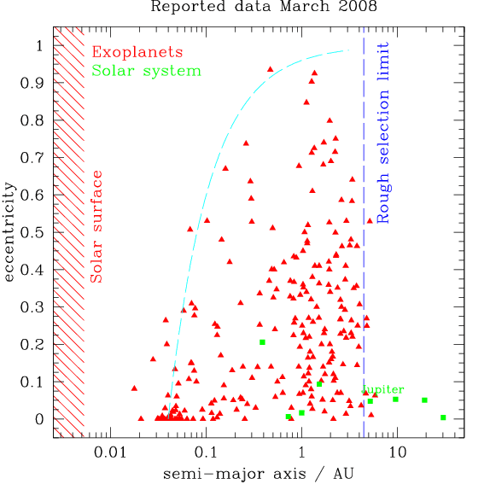
The key processes:
Migration
Dynamical instability

Slide 3
CONSTRAINTS!!
The orbits of the giant planets (non-resonant, partially eccentric and inclined)
The Earth/Mars difference (mass ratio, formation timescales)
The asteroid belt (depleted, excited, featuring 2 distinct populations partially mixed, less than 10Gy-equivalent collisional evolution)
Jupiter’s Trojans (extremely strong dynamical excitation, L4/L5 asymmetry)
Irregular satellites populations (similar for all giant planets once rescaled to the planet’s Hill radius)
The Kuiper belt (complex structure with cold, hot, resonant and scattered populations)
The Late Heavy Bombardment of the Moon
Bonus: Addressing the diversity of Planetary Systems

Slide 4
THE GAS-DISK PHASE
Giant planets form during the gas-disk phase
Terrestrial planets form later (although their precursors, the planetary embryos, form during the gas-disk phase as well)
GAS DISK MIGRATION
Isothermal disks: Type-I inward migration (Goldreich and Tremaine, 1980)
Radiative disks: possibility of outward migration (Paardekooper and Mellema, 2006)

Slide 5
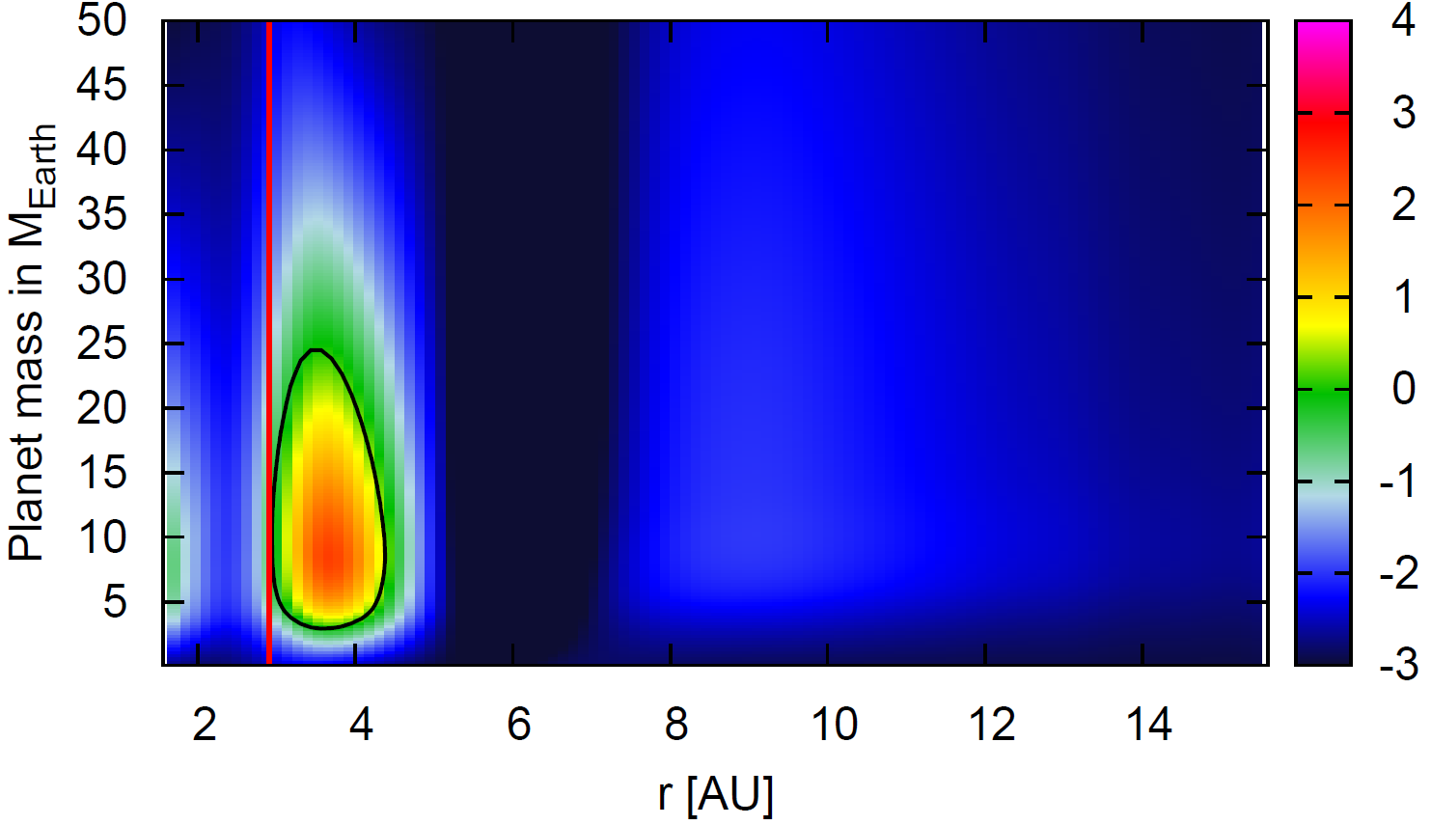
Migration vs. planetary mass in a realistic disk: formation of a giant planet
snowlinee
dM/dt=10⁻⁷M_{sun}/y
Jupiter today is here !
Migration rate
Inward Outward
Bitsch et al., 2013

Slide 6
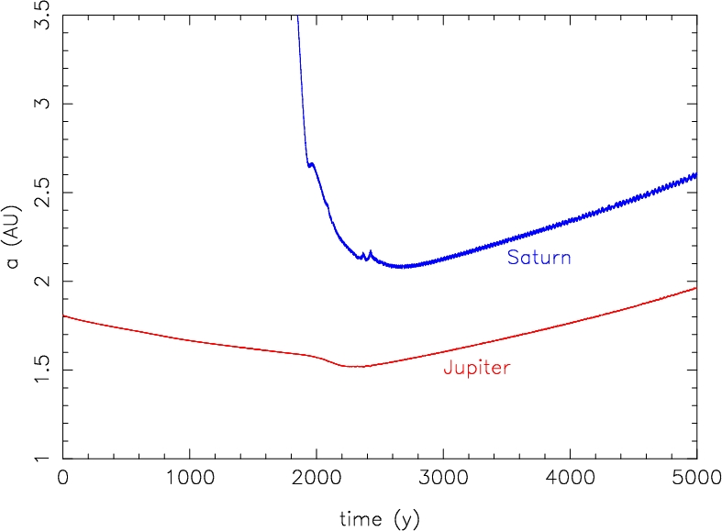
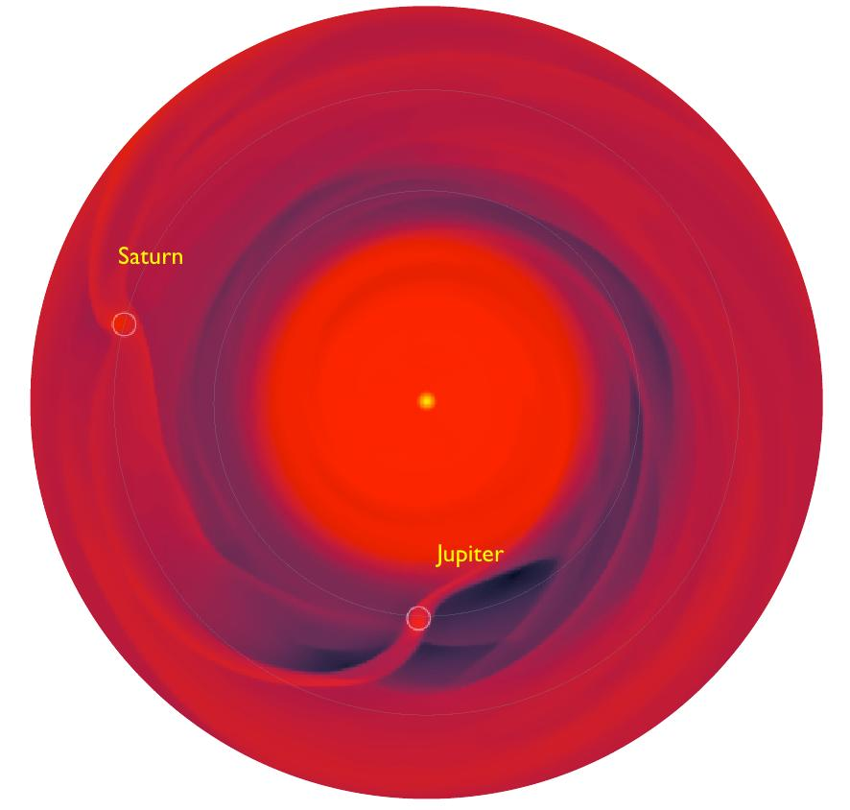
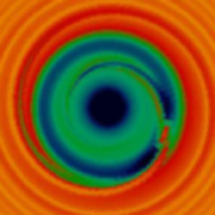
We need a mechanism to
Stop inward migration of Jupiter, so that it does not become « hot »
(ii) Bring it back to 5 AU
Possible solution: the Grand Tack (Masset and Snellgrove, 2001; Morbidelli and Crida, 2007; Pierens and Nelson, 2008; Pierens and Raymond, 2011; D’angelo and Marzari, 2012)
Courtesy of A. Crida
Semi major axis (arbitrary units)
It tacks!
Works only if Saturn is less massive than Jupiter
Time (orbital periods at r=1)

Slide 7
A PLAUSIBLE SCHEME FOR THE MIGRATION HISTORY OF THE GIANT PLANETS
Neptune
Explains why we don’t have a Hot Jupiter is the Solar System
Explains why Jupiter is « far »
Uranus
~25 M_{Earth}
Fast Migration
~Saturn Mass
~25 M_{Earth}
Saturn
Semi major axis
Capture in
Resonance
Type II
migration starting
Jupiter
~ 200 M_{Earth}
Gas disk starts to dissipate
Time

Slide 8
A PLAUSIBLE SCHEME FOR THE MIGRATION HISTORY OF THE GIANT PLANETS
Is there any evidence for the inward-then-outward migration of Jupiter?
How far inwards did Jupiter go?
To answer these questions we need to turn to constraints:
TERRESTRIAL PLANETS
ASTEROID POPULATIONS

Slide 9
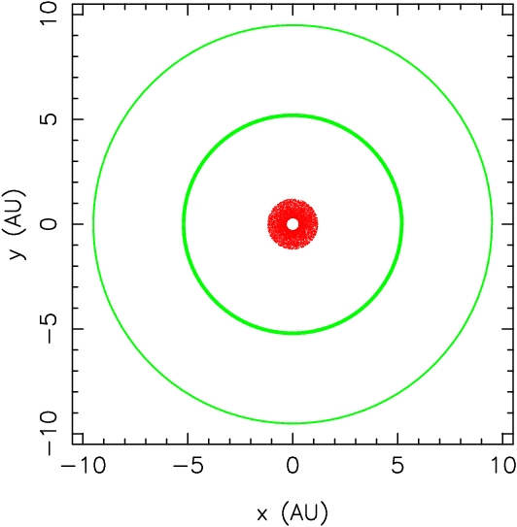
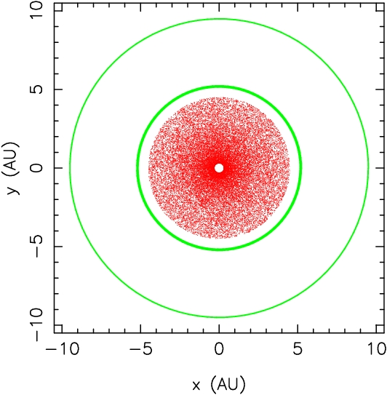
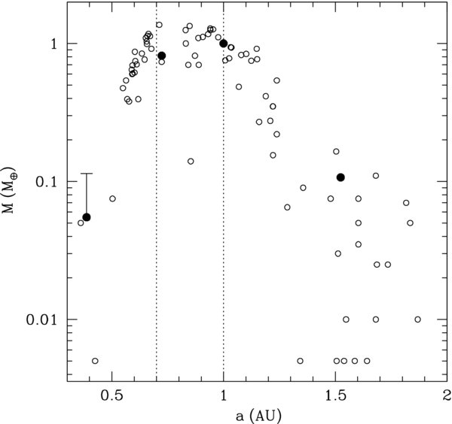
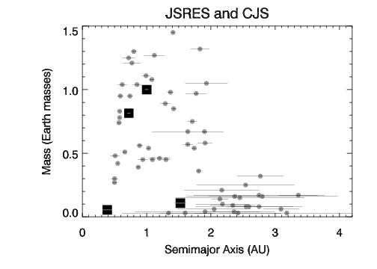
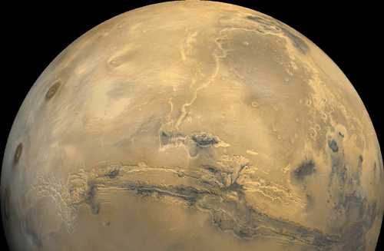
The Mars’ mass problem
Hansen, 2009

Slide 10
Can the inward-then-outward migration of Jupiter explain this?
Walsh, Morbidelli, Raymond, O’Brien, Mandell, Nature, 2011

Slide 11
Can the inward-then-outward migration of Jupiter explain this?
Walsh, Morbidelli, Raymond, O’Brien, Mandell, Nature, 2011

Slide 12
Walsh et al., 2011
S-type
C-type

Slide 13
WHAT HAPPENED NEXT (after disappearance of gas)
quasi-circular, resonant, compact orbits
Neptune
Uranus
~25 M_{Earth}
Fast Migration
~Saturn Mass
current, separated, moderately eccentric orbits
~25 M_{Earth}
Saturn
Semi major axis
Capture in
Resonance
Type II
migration starting
Jupiter
~ 200 M_{Earth}
Gas disk starts to dissipate
Gas-disk era
Time

Slide 14
Giant Planet Instability: THE NICE MODEL

Slide 15
Giant Planet Instability: THE NICE MODEL

Slide 16
Two possible evolutions from instability:
I) The divergent evolution of Jupiter and Saturn is dominated by planetesimal-driven migration
e
a
Typical timescale for Jupiter-Saturn separation: 10My

Slide 17
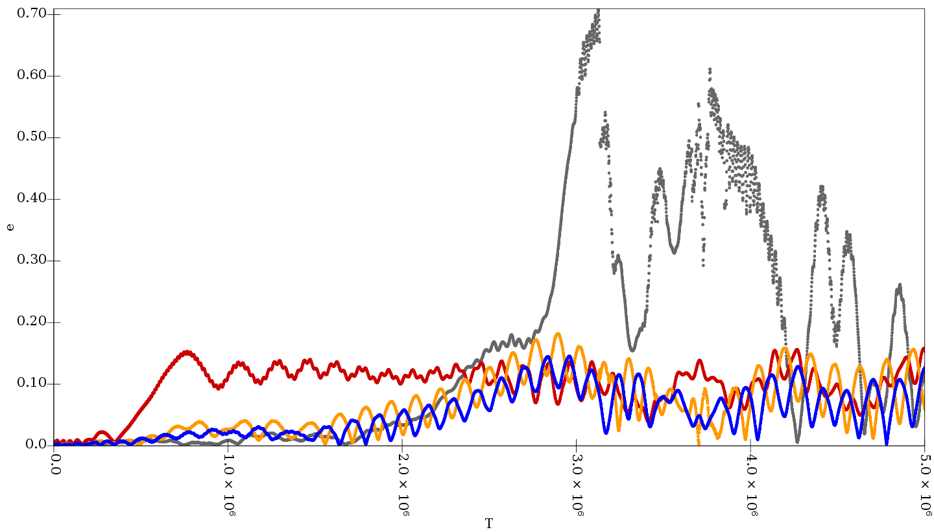
This is bad for both the evolution of the terrestrial planets (Brasser et al., 2009)
Me
Ma
E
V

Slide 18
Two possible evolutions from instability:
II) The divergent evolution of Jupiter and Saturn is dominated by encounters with Uranus or Neptune
e
a
Divergent migration takes << My

Slide 19
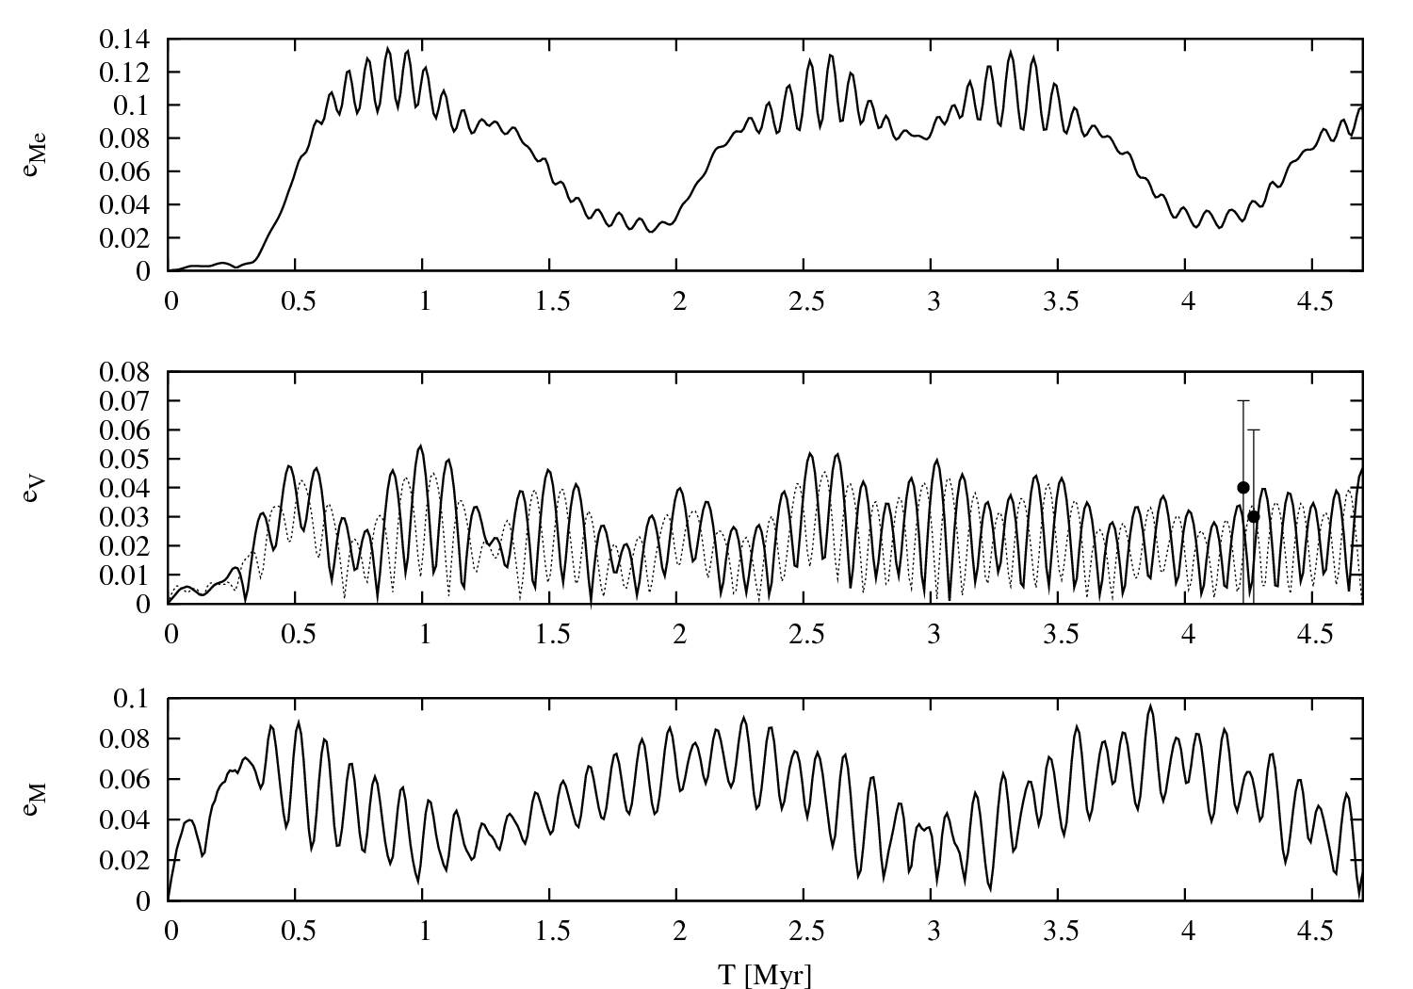
This is good for both the evolution of the terrestrial planets (Brasser et al., 2009, 2013)
Me
Ma
E
V

Slide 20
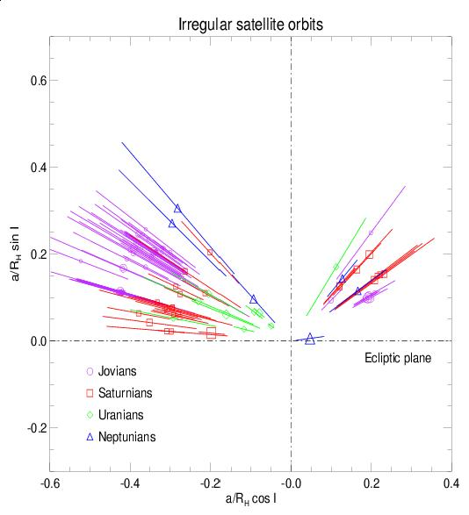
Origin of the Irregular Satellites of the Giant Planets

Slide 21
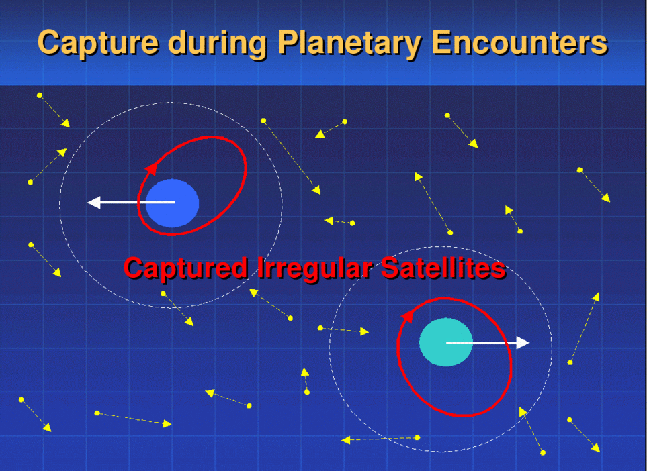

Slide 22
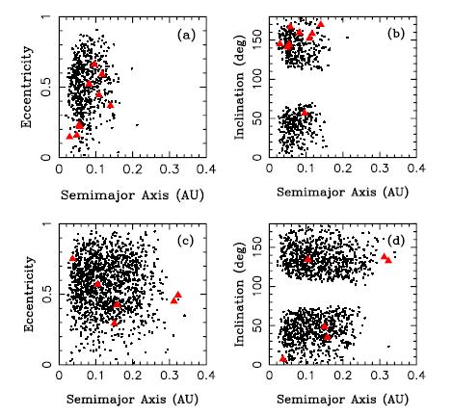
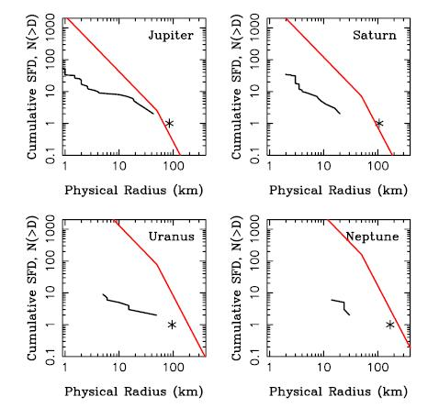
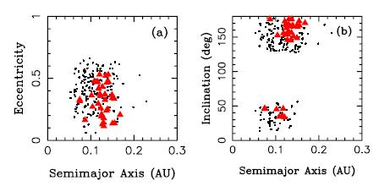
Autres implications du modèle: origine des satellites irréguliers des Saturne, Uranus et Neptune (Nesvorny et al., 2007)
Uranus
Neptune
Saturne
(Same for Jupiter)
The shallow SFD is explained by subsequent collisional evolution (Bottke et al., 2010)

Slide 23
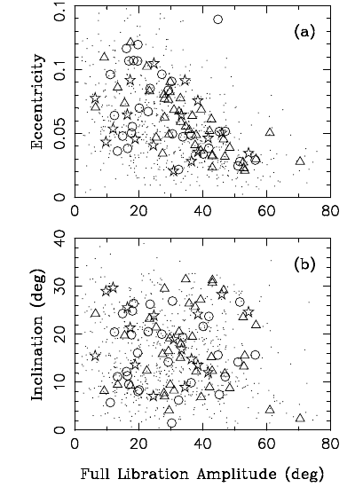
Capture of Jupiter’s Trojans during Jupiter’s last encounter
(Nesvorny et al., 2013)
This mechanism has the potential to explain the L₄/L₅ asymmetry

Slide 24
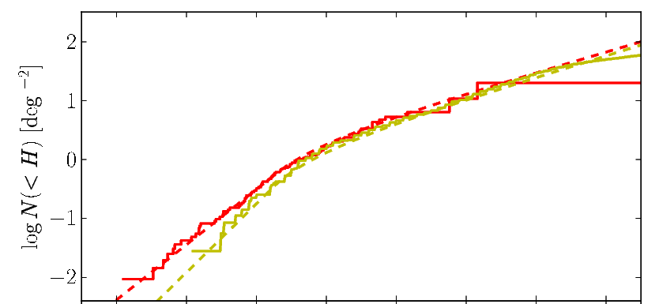
Trojan vs. Kuiper Belt H-distributions
Fraser et al., in press
Trojans (rescaled and with H corrected for albedo differences)
Hot Kuiper belt
Slope for Main belt asteroids with D>100km
Trojans and the Hot K.B. should have the same H-distribution, if the former are captured from the latter. Thus, in Morbidelli et al. (2009) we predicted that the H-dist. of the Hot KB should become Trojan-like steep at 6<H<9

Slide 25
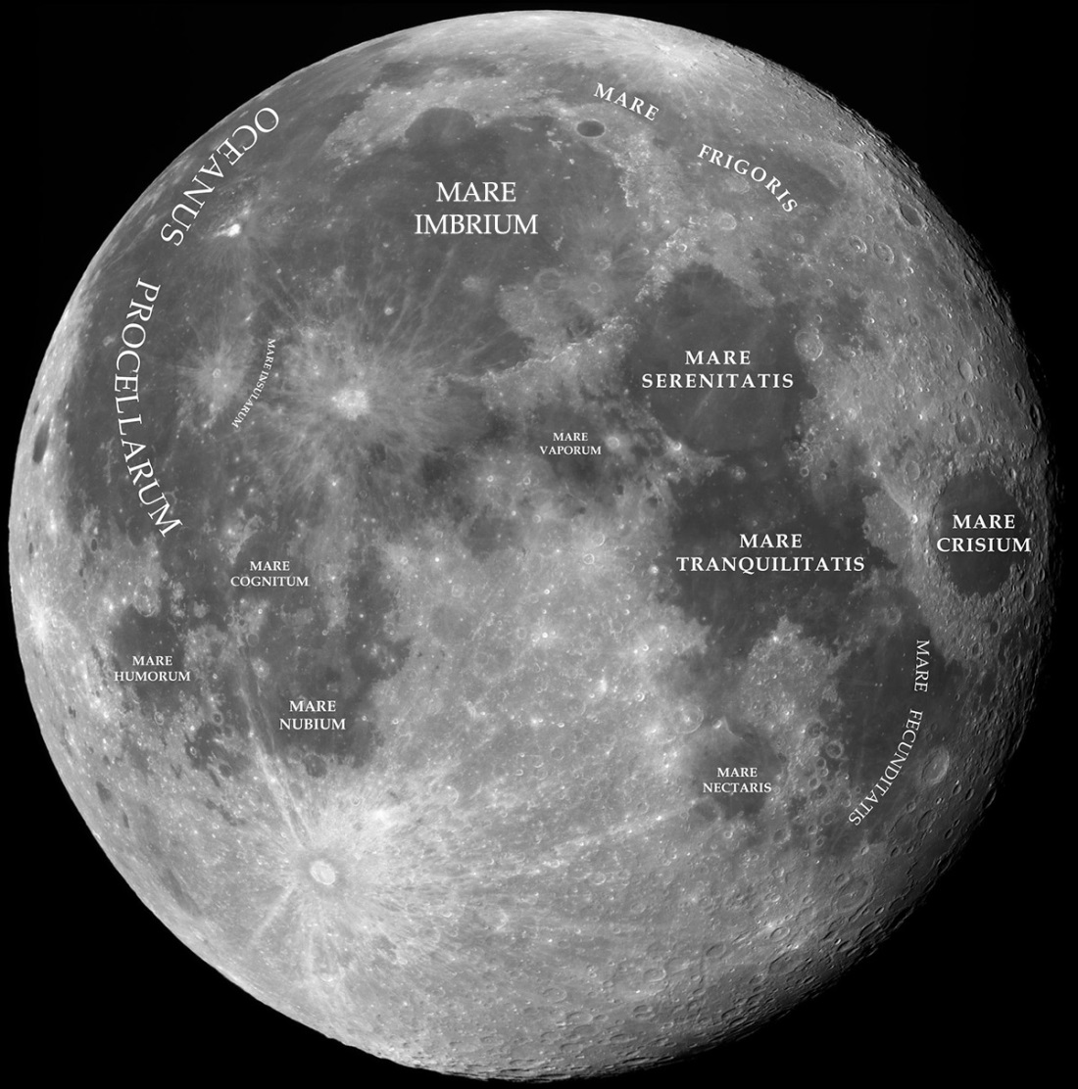
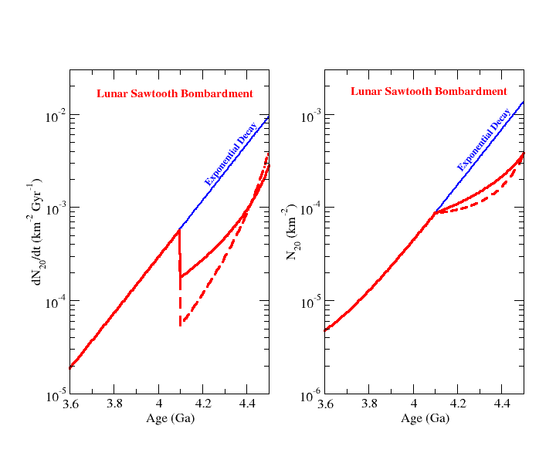
Origin of the Late Heavy Bombardment of the Moon
Morbidelli et al., 2012
Possible decays of the post-accretion bombardment
Bombardment of LHB
Bombardment rate (arbitrary units)
Beginning of LHB
Predicts ~40 basins ton the Moon, in agreement with what was later found by GRAIL!
Last basin-forming event

Slide 26
WRAP-UP ON SOLAR SYSTEM EVOLUTION
By looking carefully to all available constraints, our ambition is to reconstruct as precisely as possible, the past history of the Solar System
Two-phase scenario of the evolution of the giant planets
A gas disk phase: fully resonant, low-e configuration; no hot Jupiter, although wide range radial migration and “Grand Tack”
A planetesimal-disk phase: global instability; excitation of e, i and secular modes; migration (jump) to current orbits
If true, it argues that:
The Solar System evolution was dominated by the same processes that affect every planetary system: migration and instabilities.
The actual structure of the Solar System depends on specific fortuitous features/events (Saturn did not grow more massive than Jupiter, the 4 giant planets did not become violently unstable …).

Slide 27
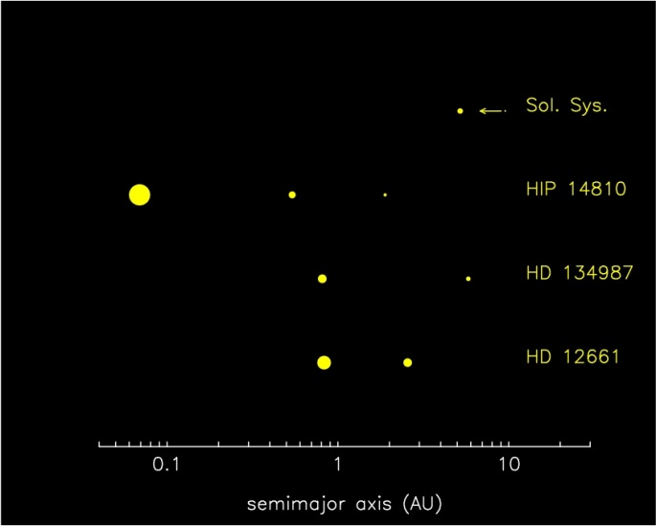
ESSAI ON THE DIVERSITY OF PLANETARY SYSTEMS
Consider two giant planets P1 and P2, forming in sequence (P2 beyond P1)
Q:
Does the second, lighter planet catch the first one in resonance?
Yes/No
For the Solar System the answer is YES
For HD 12661, HD 134987, HIP14810 the answer is NO

Slide 28
Q:
Does the second planet eventually grow as massive or more massive than the inner one?
Yes/No
For the Solar System the answer is NO
For many/most other systems the answer could be YES
What happens if planets form faster and the outer one has the time to outpass in mass the inner one?
Migration starts again….

Slide 29
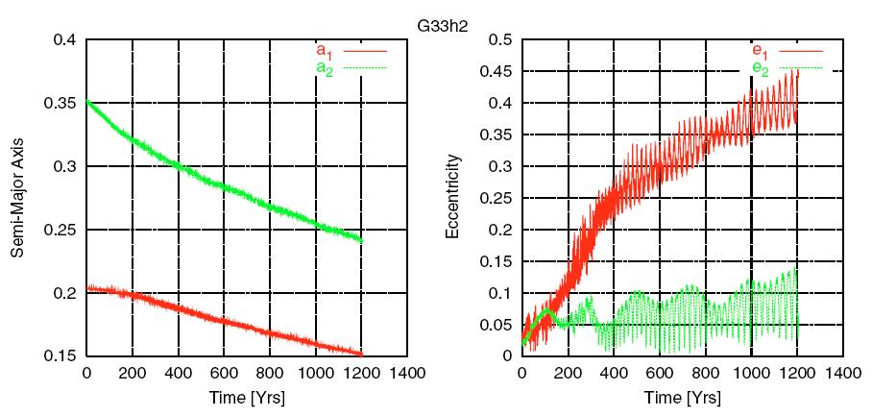
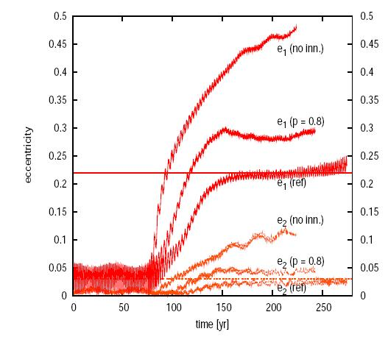
Gliese 876
Kley et al. 2004, 2005; Crida et al., 2008
Migration drives the inner, lighter planet to become eccentric
Q:
Does the eccentricity of the inner planet saturate ?
Yes/No
For the pairs of resonant planets: YES
For single, eccentric planets: NO

Slide 30
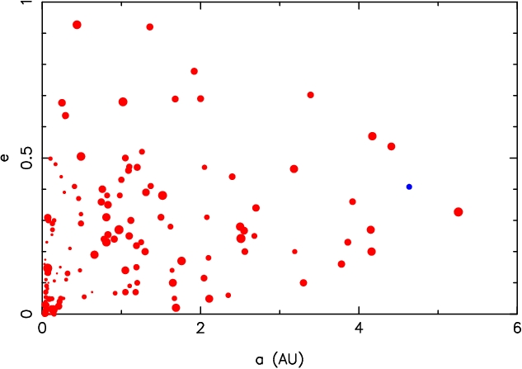
Consider finally a system that evolves exactly like the Solar System up to the final giant planet instability
Statistics on the « Nice model »
4planets survive
Saturn ejected
Uranus or Neptune ejected
Jupiter if Saturn ejected

Slide 31
CONCLUSIONS
Branching events can explain most of the observed diversity:
Does the second, lighter planet catch the first one in resonance?
For more discussion see my chapter “Dynamics of Planetary Systems” available on AstroPH
NO
YES
HD 12661& Co.
Does the second planet eventually grow as massive or more massive than the inner one?
NO
YES
Does a violent late instability occur ?
Does the eccentricity saturate ?
NO
YES
NO
YES
Eccentric distant planets
Eccentric single close-in planets
resonant pairs (Gliese 876)
Solar System

