Slide 1

Monitoring blazar variability at radio wavelengths using Brazilian facilities
Pedro P.B. Beaklini (IAG/USP)
Tânia P. Dominici (MAST/MCTIC)
Zulema Abraham (IAG/USP)
Juliana C. Motter (IF/UFRGS)
LIneA Webinar
12/09/2019

Slide 2
Blazars
High luminosity AGNs
Bright at radio wavelengths.
VVO and BL Lacs - shows variability at all wavelengths.
Small angle between the jet and the line of sight
Therefore, blazars were intensively monitoring at cm wavelength.

Slide 3
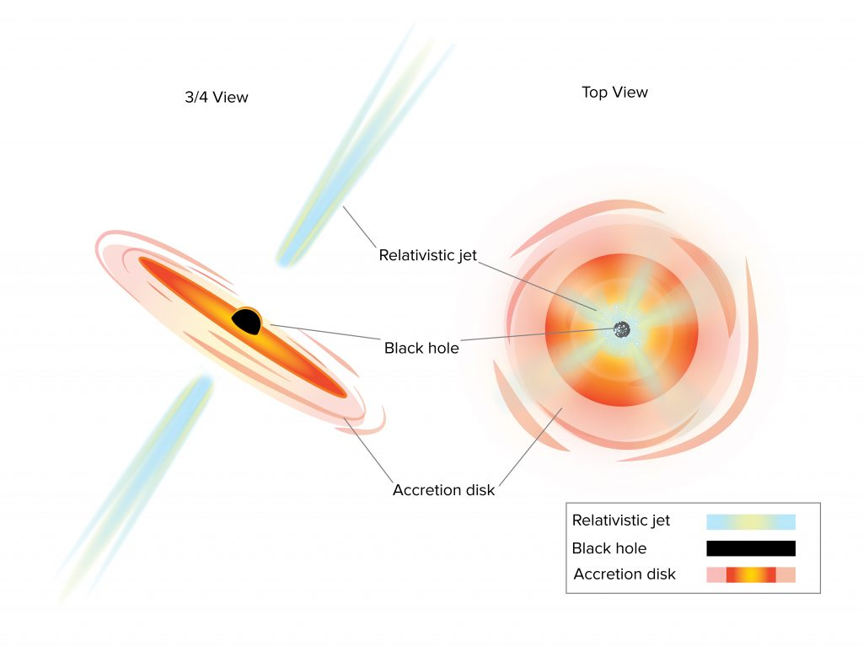
Looking “inside” the jet
Image Credit: NRAO website. Gallery
https://public.nrao.edu/gallery/agns-seen-at-different-angles/

Slide 4
Relativitisc Effects
Beaming effects
  (Rees 1966; Blandford & Königl 1979)
High - Variability
Doppler Factor
Lorentz Factor

Slide 5
Superluminal Velocities
Components
Image at 22 GHz (VLBA)
Source: 3C279
Jet component evolution
Time (Years)
Light-year
Original: Wehrle et al. 2001 (NRAO Gallery)
Adapted: Motter 2017

Slide 6
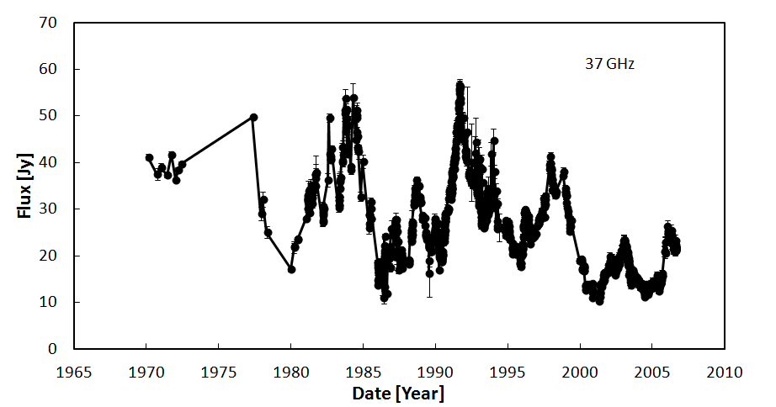
Variability (3C273)
Soldi et al. 2012

Slide 7
Understanding the Variability
Quiet and Active phase
At last during flare activity
  Delays between radio variability and high energy variability
  First seen in 3C273, on an IR flare (Robson et al. 1983, Cleeg et al. 1983, Botti & Abraham 1988), Stevens et al. 1994, 1998)

Slide 8
Shock-in-jet model
Marscher & Gear 1985
Generalizations (e.g.): Hughes, Aller&Aller 1985; Türler, Corvoisier & Paltani 2000;Spada et al. 2001; Marscher & Jorstad 2010; Hughes, Aller & Aller
2011),

Slide 9
What is going on?
The shock model
  Initially Optically thick component expand and become brighter until turn to a optically thin to a given frequency.
  Predict time delays of few days between high energy (gamma and X-Ray) and optical, and few months between high energy and radio
High
Energy
Higher time delay for the lower frequencies
Radio
Frequencies
Delay

Slide 10
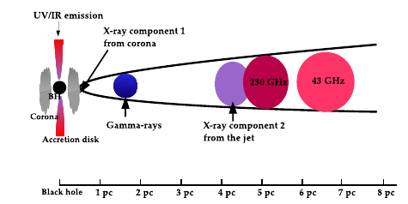
Shock-in-jet schema
Chidiac et al. 2016

Slide 11
To keep aware
On the source frame, time is different than the obs frame
The duration of each flare is different through the spectrum. Gamma-ray flares are shorter than radio flares
More than simultaneous observations, we need simultaneous monitoring

Slide 12
Objectives

Slide 13
XXI Century
new amount of variability data
Gamma-Ray Fermi
X-Ray – XMM, Chandra
Optical, IR – SMARTS monitoring (Bonning et al. 2008)
Radio cm – Historic Light Curve
Submillimetric - Few monitoring data from phase calibrators sources.
ROPK
LLAMA

Slide 14
Blazars SED Before Fermi
Rádio
Raios-γ
Fossati et al. 1998. SED (Spectral Energy Distribution) dof122 blazares. Before Fermi

Slide 15
Source List
Name | α (h) | α (m) | α (s) | δ (g) | δ (') | δ (")
PKS 0537-441 | 5 | 38 | 54.4 | -44 | 5 | 9
PKS 0727-11 | 7 | 30 | 19.1 | -11 | 41 | 13
OJ 287 | 8 | 54 | 48.8 | 20 | 6 | 31
3C 273 | 12 | 29 | 6.6 | 2 | 3 | 8
3C 279 | 12 | 56 | 11.1 | -5 | 47 | 22
PKS 1510-089 | 15 | 12 | 50.5 | -9 | 5 | 60
AP Lib | 15 | 17 | 41.8 | -24 | 22 | 20
SgrA* | 17 | 45 | 40 | -29 | 0 | 28
OT 081 | 17 | 51 | 32.8 | 9 | 39 | 1
4C 11.69 | 22 | 32 | 36.4 | 11 | 43 | 51
3C 454.3 | 22 | 53 | 57.7 | 16 | 8 | 54

Slide 16
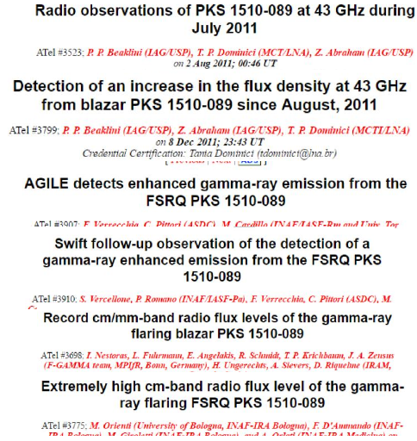
Let’s do it
Radio monitoring
Polarimetric monitoring
To compare
Fermi Light curve
Others programs
FAST Comunication

Slide 17

Observations

Slide 18
Radio Observations
7mm (43 GHz) observations at Itapetinga radio observatory (Atibaia, Brazil)
Monthly Basis:
  1510-089: between 2011 and 2013
  3C279: between 2009 e 2013
Beam size: 2.4 arc minute (Point source)
Flux Calibrators: VirgoA(Primary) e SgrB2 Main (Secundary)

Slide 19
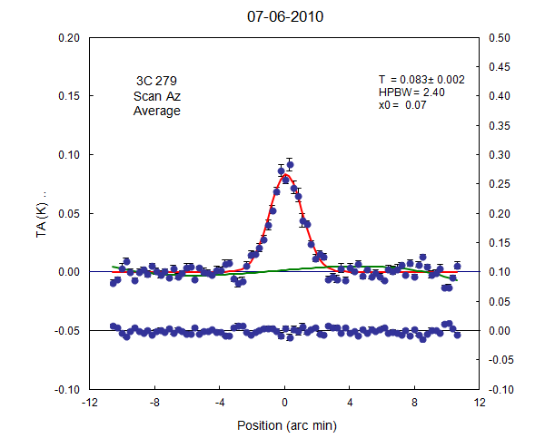
Scan Method (on-the-fly)
  Scan at elevation and azimuth Scan time: 20 seconds
  Scan Amplitude: 30 arcminute Scan Points: 81
90 minutes of observation of 3C279

Slide 20
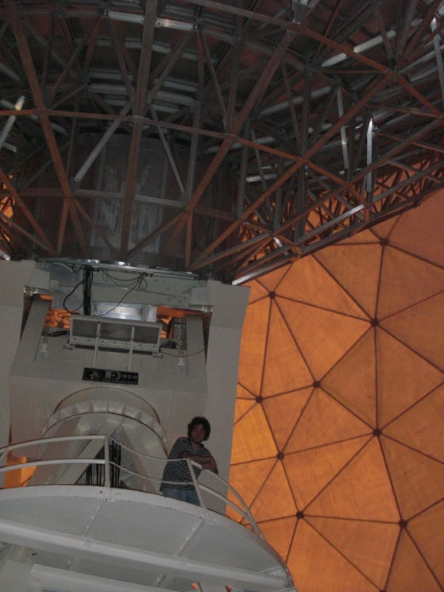
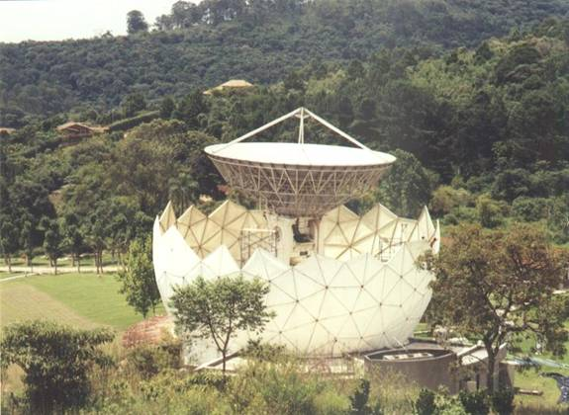
ROPK (former ROI)

Slide 21
Optical Polarimetric Observation
(R Band)
Observations at Pico dos Dias Observatory
Between 2009 and2013 for both sources .
Imaging Polarimeter IAGPOL (Magalhaes et al.1996).
  The polarimeter consists of a rotable, achromatic half-wave retarder, followed by a calcite Savart plate.
Data Reduction: IRAF PCCDPACK package (Pereyra 2000).

Slide 22
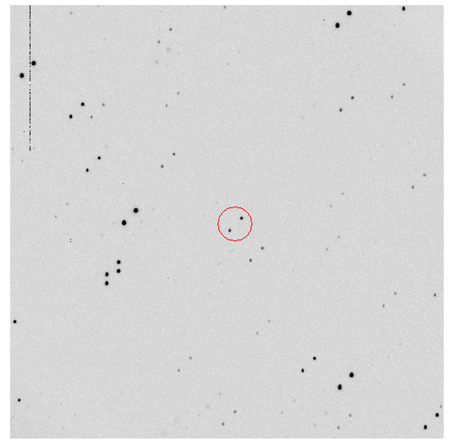
3C279

Slide 23
Can we recovery Magnitude information?
3C279
1510-089
Small and
Moderate Aperture Research Telescope System
Beaklini 2012
SMARTS data: Bonning et al. 2008

Slide 24
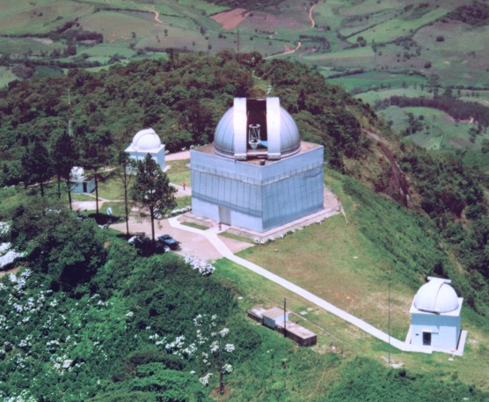
OPD - IAGPOL

Slide 25
Results

Slide 26
3C273 -
March
2010
Setember
2009
180 days delays. High energy coming first
Beaklini & Abraham 2014

Slide 27
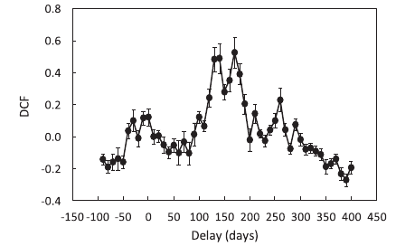
DCF Method
Edelson & Krolik 1988
Beaklini & Abraham 2014

Slide 28
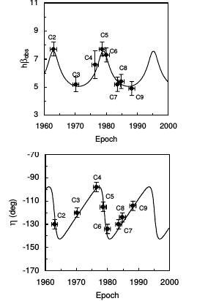
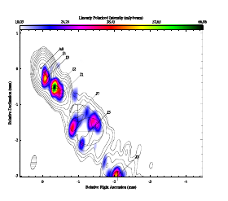

3C273 jet
Período de 16 anos
Marscehr & Gear 1985
Jortstad et al. 2013
Abraham & Romero 1999

Slide 29
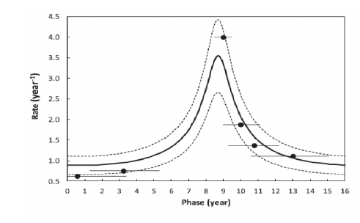
3C273
Beaklini & Abraham 2014

Slide 30
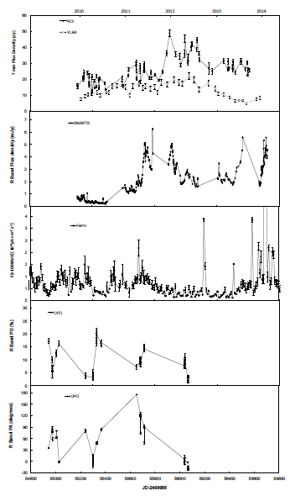
3C279
SMARTS
Fermi/LAT
Beaklini et al. 2019

Slide 31
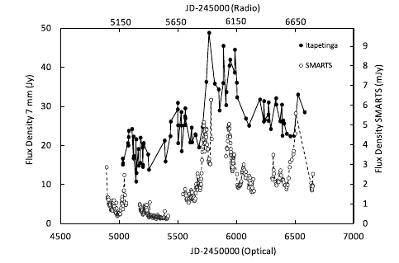
3C279
Beaklini et al. 2019

Slide 32
Time Delay Radio-Gamma: 3C279
DCF
150 days delay
Beaklini et al. 2019

Slide 33
QxU Plane
Beaklini et al. 2019

Slide 34
PKS 1510-089
SMARTS
Fermi/LAT
Beaklini et al. 2017

Slide 35
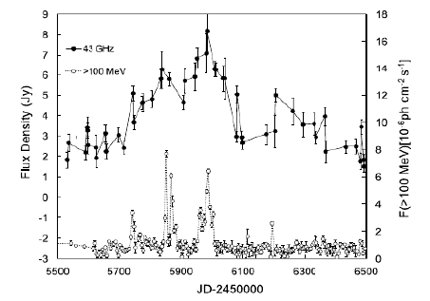
PKS1510-089
Beaklini et al. 2017

Slide 36
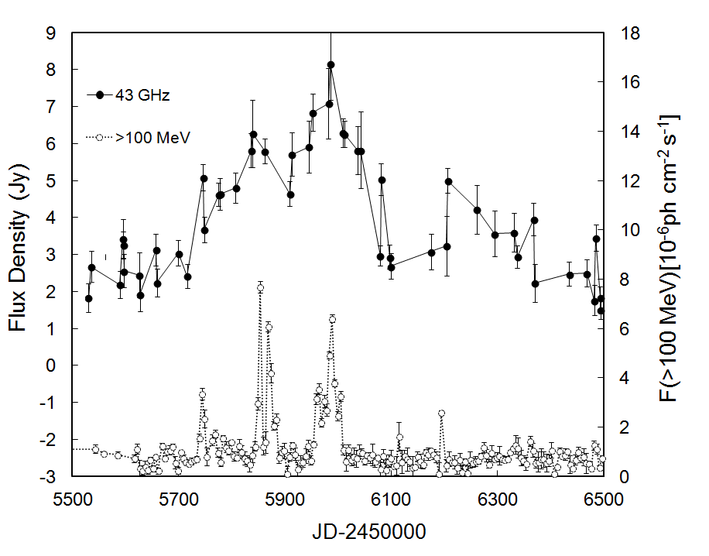
Time Delay – Radio-Gamma:1510-089
Delay of ≅ 55 days

Slide 37
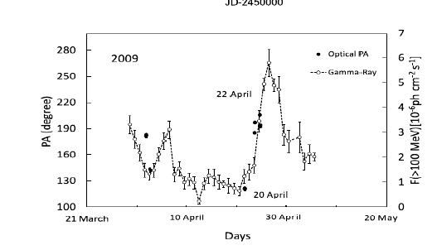



PKS1510-089
Beaklini et al. 2017

Slide 38
PD x Magnitude relation
Similar result was found by Sasada et al.(2011) and Ikijiri et al.(2011).

Slide 39

Instrumentation

Slide 40
Radio Observatório Pierre Kaufmann

Slide 41
ROI Before our monitoring
Most of the time: Only continuum receivers
  43 GHz and 22 GHz
    Not easy switch between the frequencies
Pointing and tracking problems

Slide 42
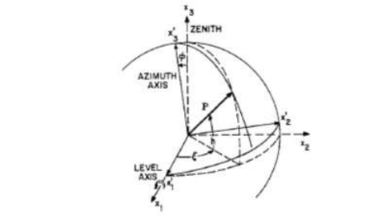
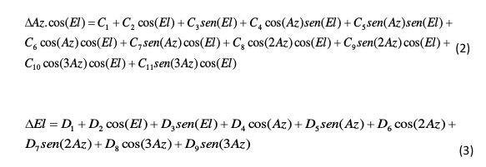
Radio Pointing
Rádio Observatório do Itapetinga
(Pierre Kaufmann)
Figure: Meeks et al. 1968

Slide 43
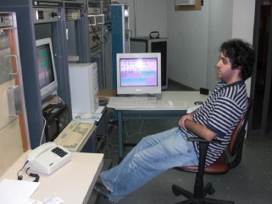
Other issues
8 years of observation
  Calibration
Problems diagnostic
  (Receiver, voltmeter, attenuators, GPS, tracking,
  motor, water)

Slide 44
ROI to ROPK
Partnership Mackenzie-INPE
  IAG/USP – instruments
22 and 43 GHz receivers
  Line and continuum
Both bands simultaneous
New Motors

Slide 45
Large latin america millimeter array

Slide 46
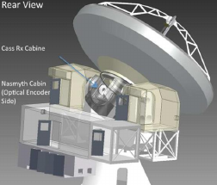
LLAMA
Brasil & Argentina
12m
  Cassegrian Focus
4.800 m
  Atacama Desert
Receivers
  35-50 GHz (1), 66-116 GHz (2-3), 162-211 GHz (5), 211-275 GHz (6),275-373 GHz (7), 620-720 GHz (9)

Slide 47
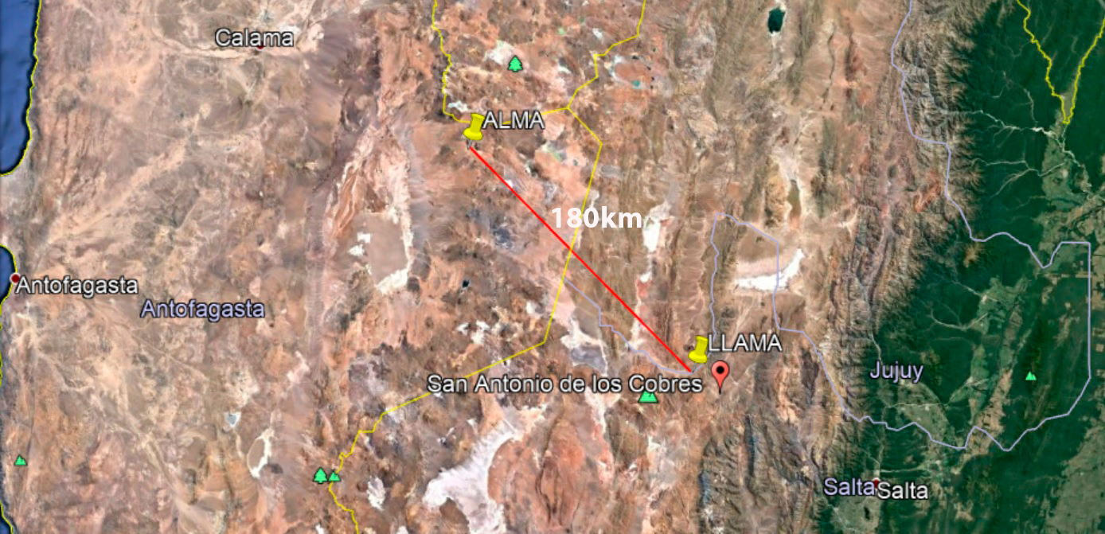
Where??

Slide 48
LLAMA Commissioning Plan
● Test of alarms and security system
● Antenna movements and software verification
● Optical pointing
● Holography
● Receivers installation
● Radio pointing

Slide 49
Holography
Surface Quality
  How can we measure?
  Can we improve it?
Illumination and Aperture efficiencies
Receiver offset
Optical Problems (?)

Slide 50
How?
Check the radiation response at each part of the dish:
  Measuring amplitude and phase. How? Holography
Holography technique consists to measure radiation pattern coming from different parts to determine large errors on its surface.

Slide 51
Scan
Source
Baars et al. 2007

Slide 52
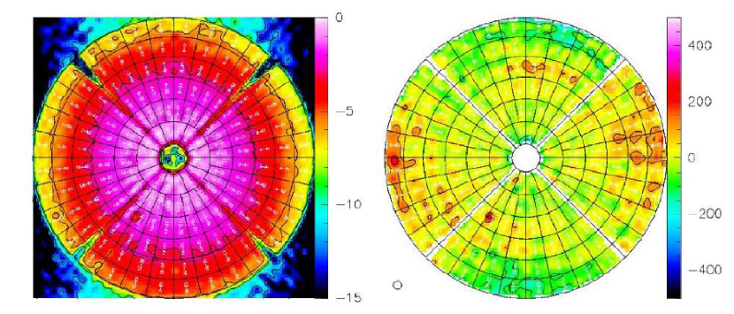
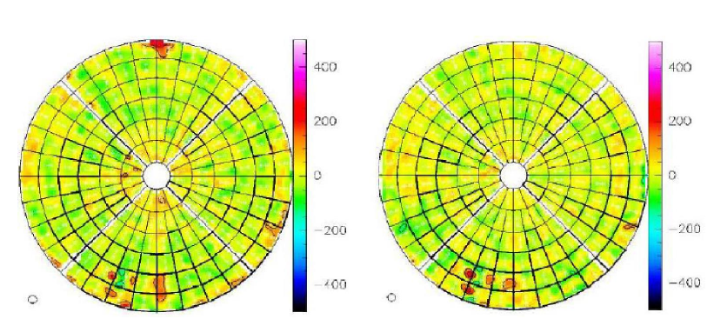
Holografy Measurements
NOEMA Antenna
Together with Roberto Neri (IRAM) and Jan-Martin Winters (IRAM)

Slide 53
Conclusions
Monitoring blazars is a key to understand about AGN jets
  Simultaneous multiwavelength observations are necessary
We can do it from here! But we need to think in instrumentation
  ROPK -> classic centimeter wavelength
  LLAMA -> mm/sub-mm range

Slide 54

FIM

