Slide 1
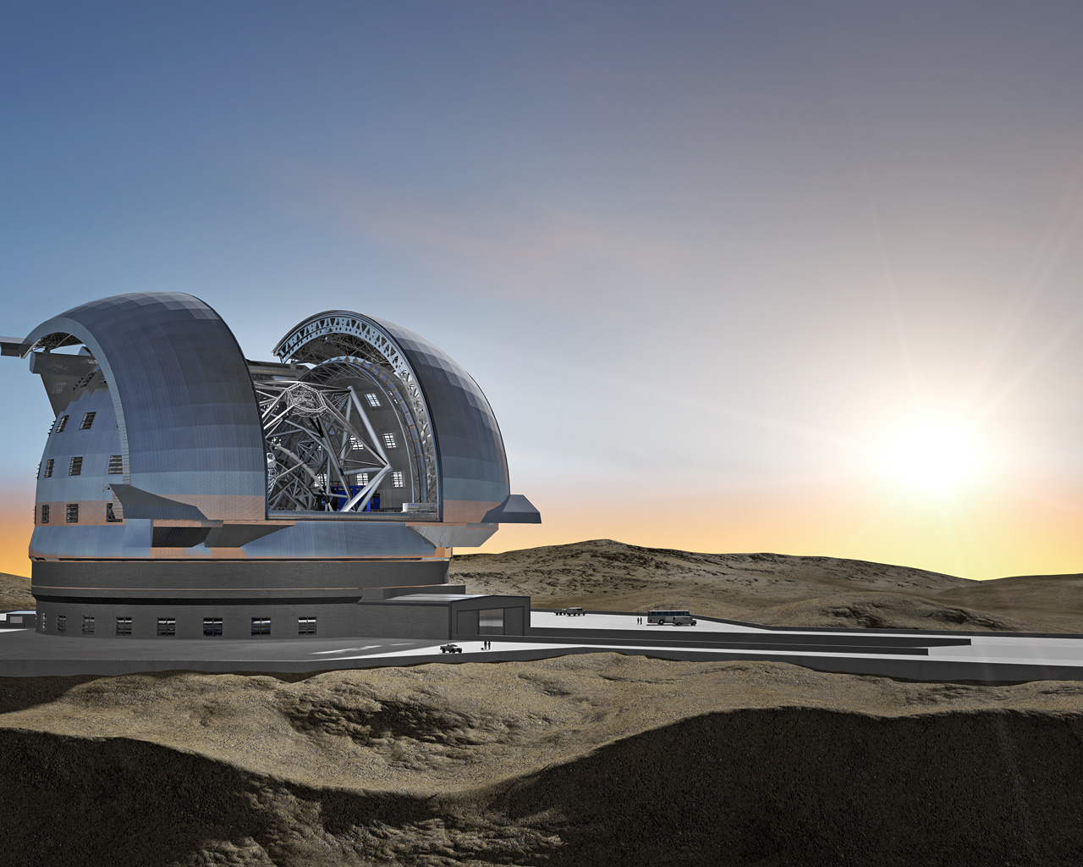

Simulation-based integral field studies of high-z galaxies with E-ELT HARMONI
Sarah Kendrew
University of Oxford
Sarah.kendrew@astro.ox.ac.uk
@sarahkendrew

Slide 2
Everything in this talk is simulated
“High z” ca. 2015 ≠ “High z” ca. 2025

Slide 3
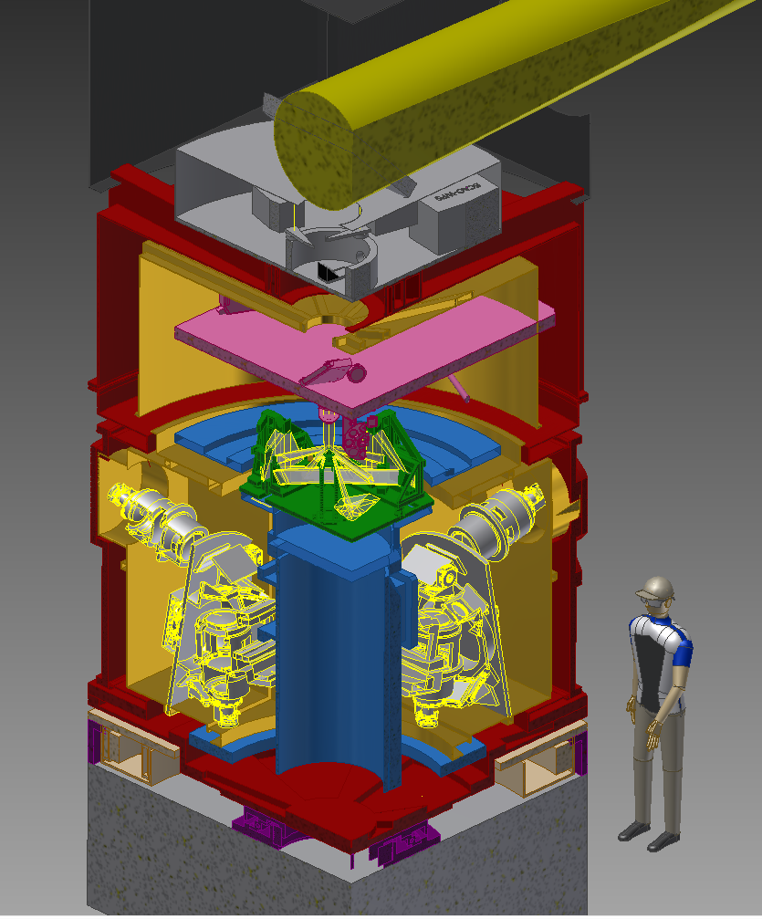
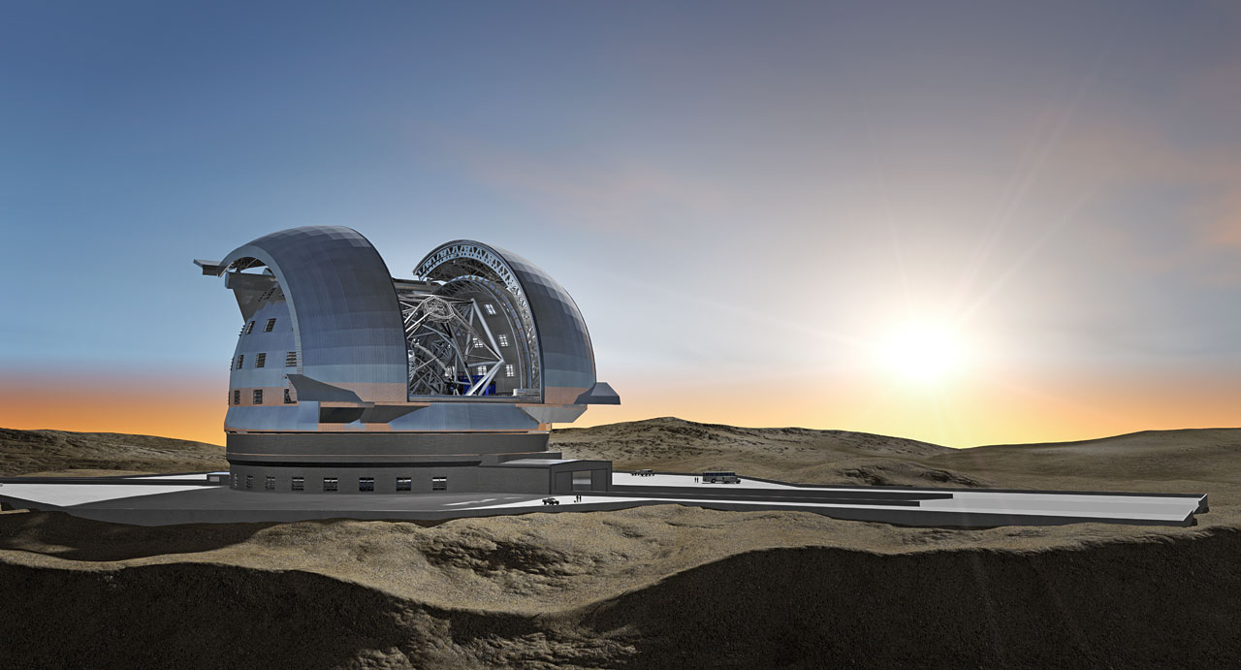










HARMONI
A first-light integral field spectrograph for the European ELT
Thatte et al, SPIE 2014

Slide 4
The European Extremely Large Telescope (2024)
39-m primary mirror
5-mirror optical design for 2’ field of view
Adaptive optics fully integrated
2 first-light instruments: MICADO, HARMONI
Status 2015
Brazil?
Dec 2014: Green light for phased approach
Cost-capability analyses for instruments
LTAO?

Slide 5
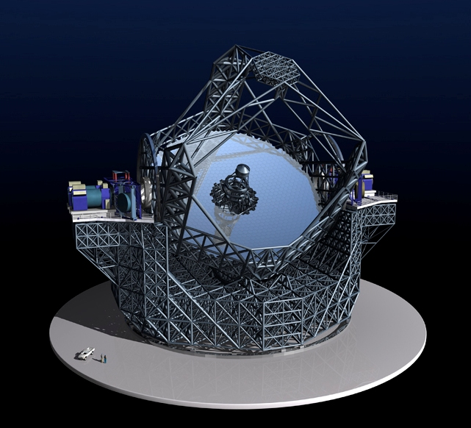
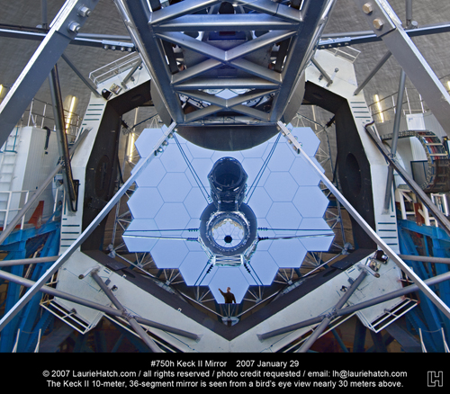
39-m diameter primary mirror
798 hexagonal 1.4-m segments
Position & tilt actively controlled
4-m secondary mirror
Instrument stations
(Tiny humans)
+ adaptive real-time correction of atmospheric turbulence

Slide 6
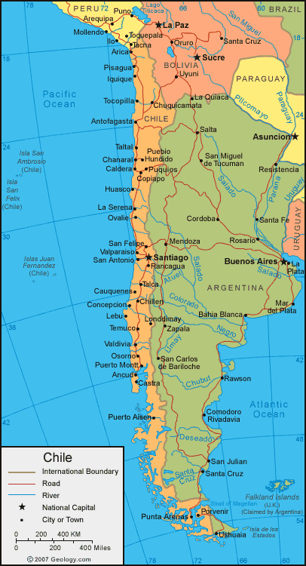
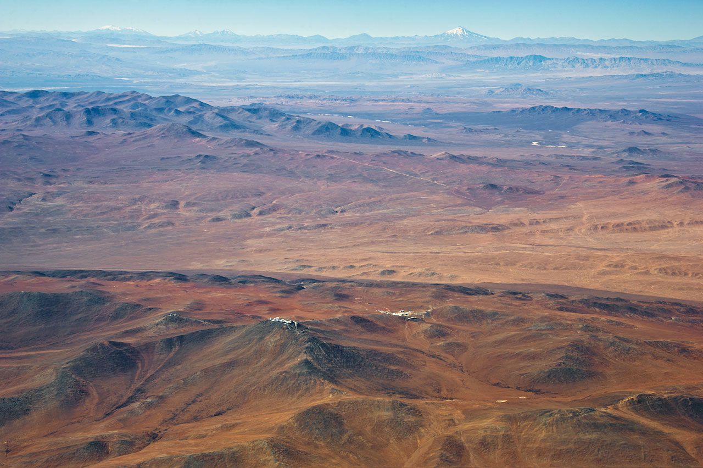
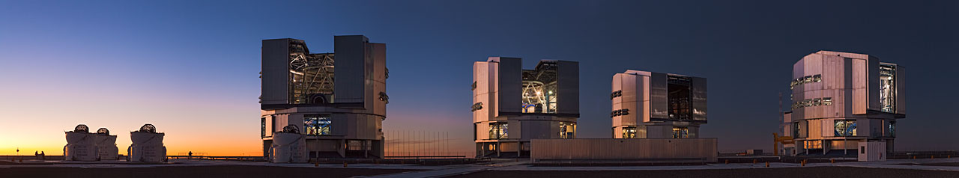
Cerro Armazones, Chile
Armazones
Paranal
Residence
ESO/M. Tarenghi
ESO/B. Tafreshi

Slide 7
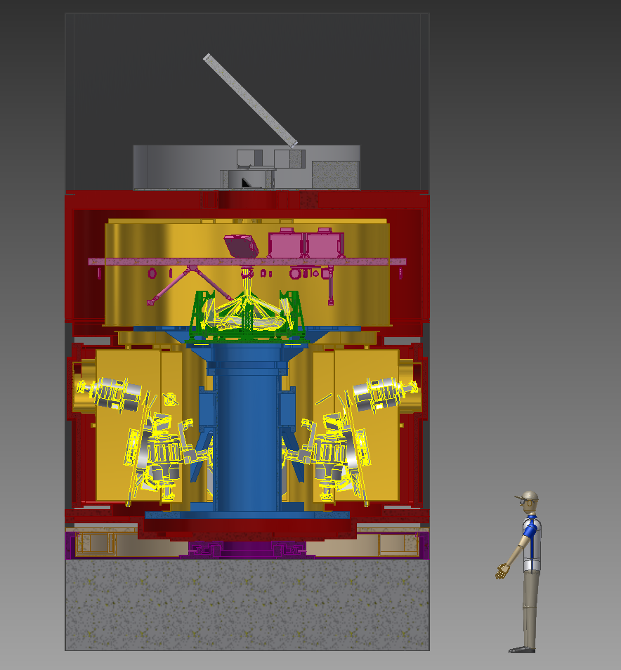
HARMONI Overview
“Workhorse” spectrograph for the E-ELT
Covers ~0.5 – 2.5 µm (visible and near-IR)
Resolving powers from ~500 to ~20000
Provides in 1 exposure 32,000 spectra!
4 spatial setting depending on target

Slide 8
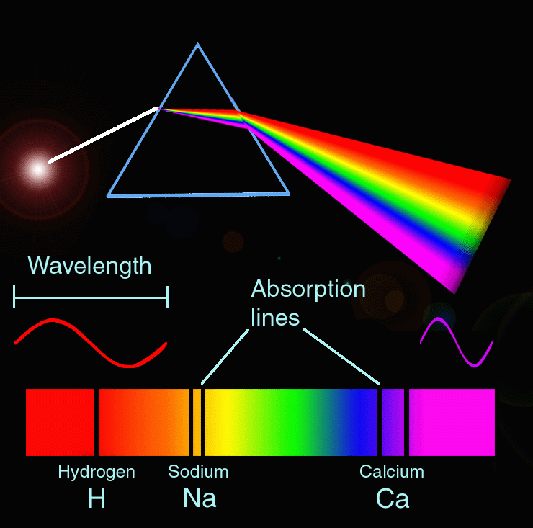
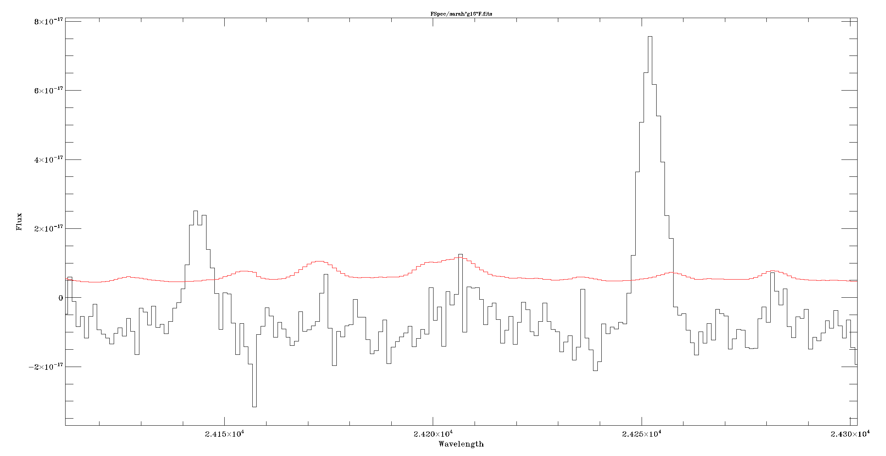
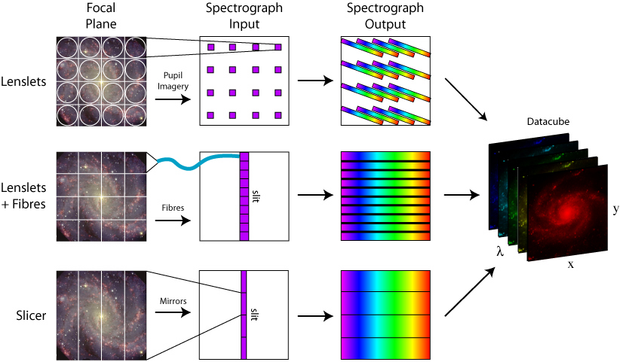
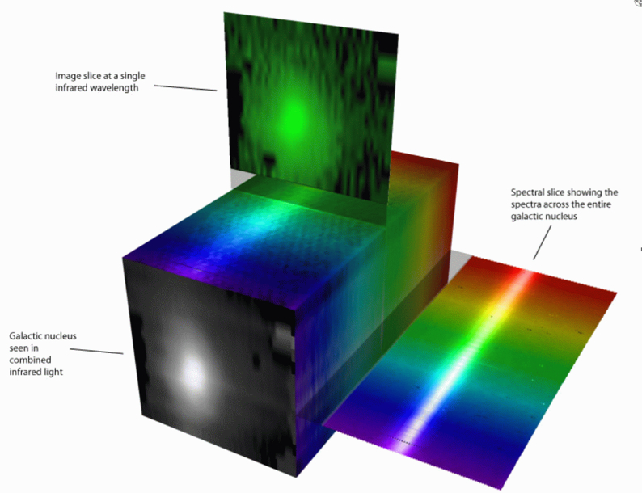
3D (Integral Field) Spectroscopy
“Simple” spectroscopy:

Slide 9
20 mas
10 mas
4 mas
60 mas × 30 mas
Best combination of sensitivity and spatial resolution
Highest spatial resolution (diffraction limited)
For non-AO & visible
observations
For optimal sensitivity (faint targets)
6.42” × 9.12”
Equivalent slit length: 16 arcmin
or
3.2 metres in ELT focal plane
3.04” × 4.28”
~152 × 214 (32000) spaxels at all scales
7
1.52” × 2.14”
0.61” × 0.86”

Slide 10
All your favourite IFU science will be possible with HARMONI
Stellar populations of galaxies to the Virgo cluster
Physical properties of exoplanets
Characterisation of high-z supernovae
Dynamics and star formation properties of high-z galaxies
Resolved spectral images of Solar System objects
… and much more!

Slide 11
Current status
Much planning and re-planning in recent years
Official signing of the contract between ESO & STFC in September 2015
Official kick-off to the Preliminary Design Phase, Oct 2015

Slide 12
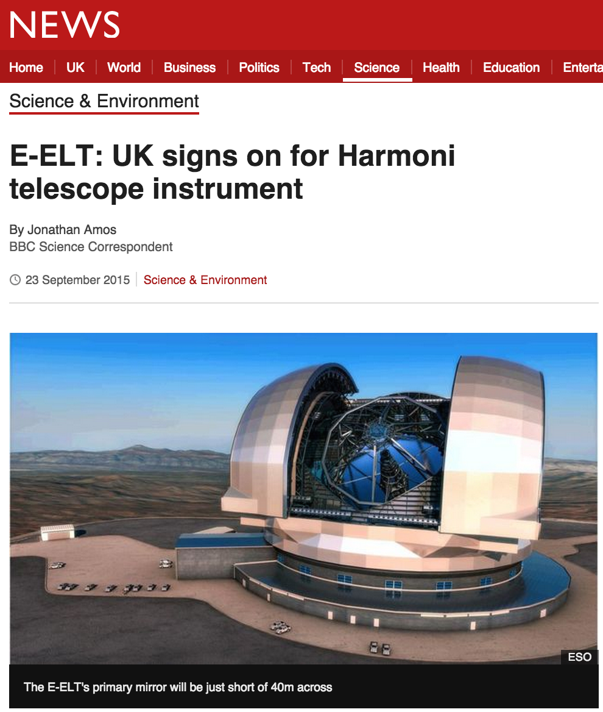
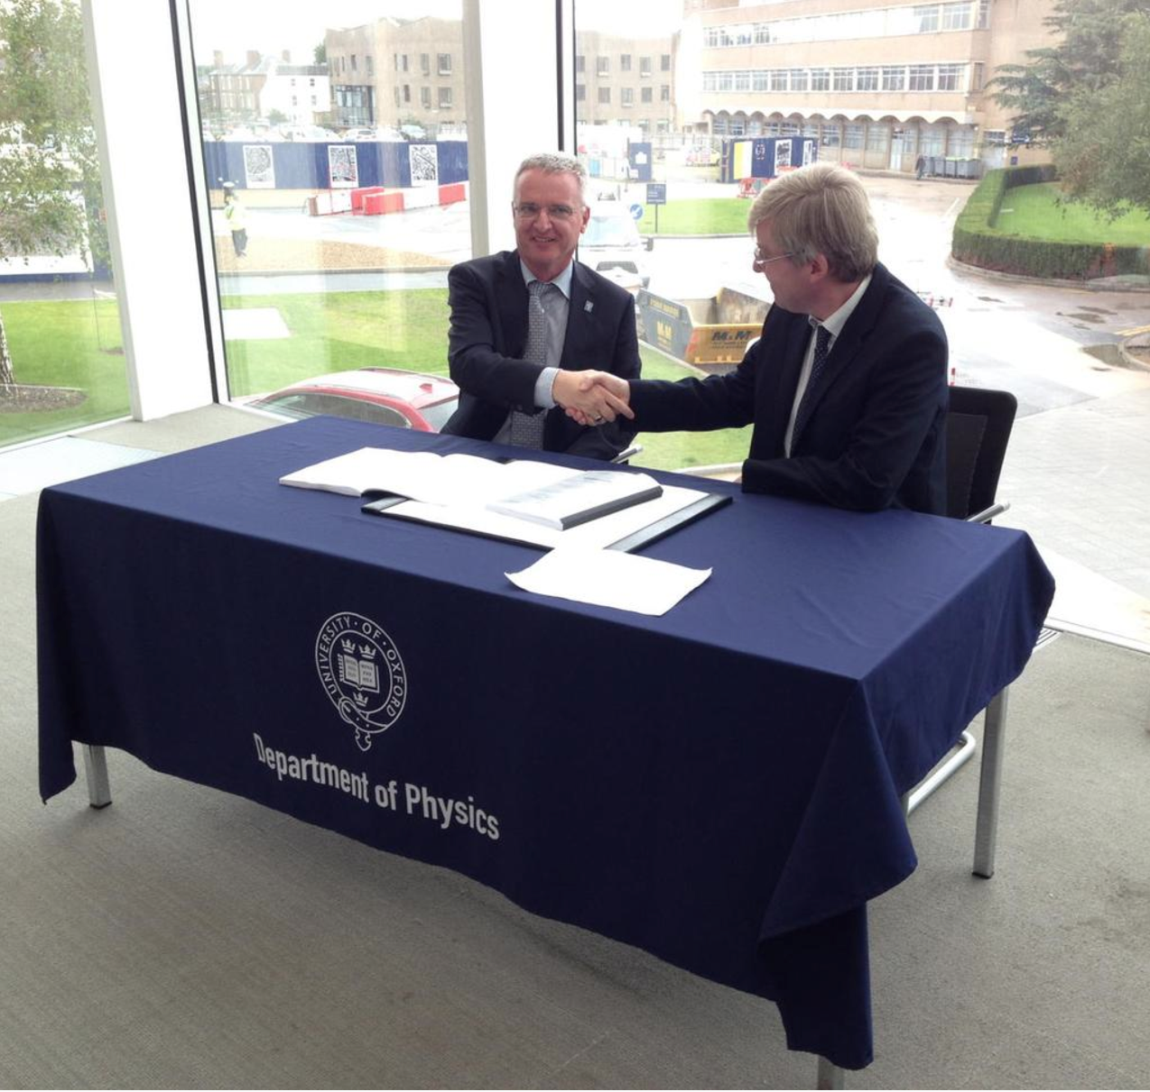

Slide 13
Aims
Maximising the scientific return from E-ELT/HARMONI in the study of high-z galaxies
Observational predictions from cosmological simulations for the ELT era

Slide 14
The harmoni simulator
Comprehensive instrument modelling
S. Zieleniewski et al, MNRAS 2015

Slide 15
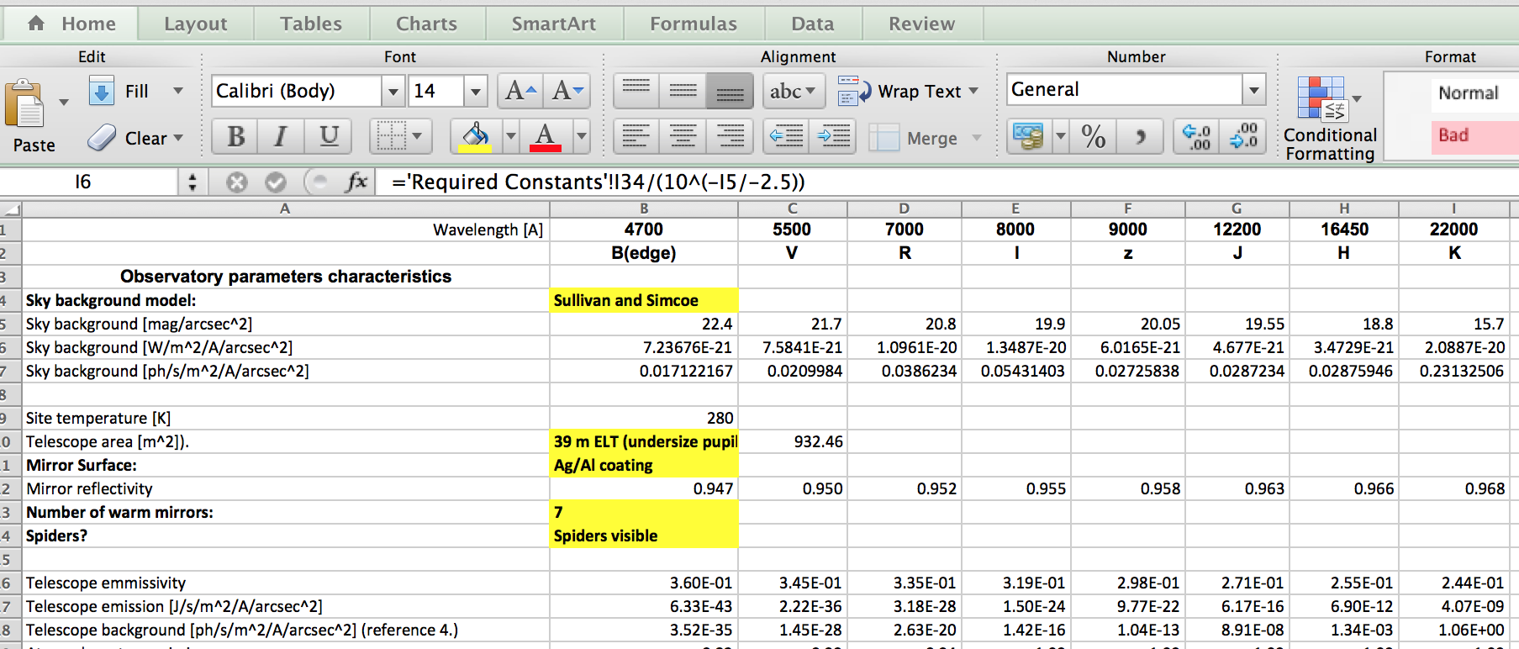
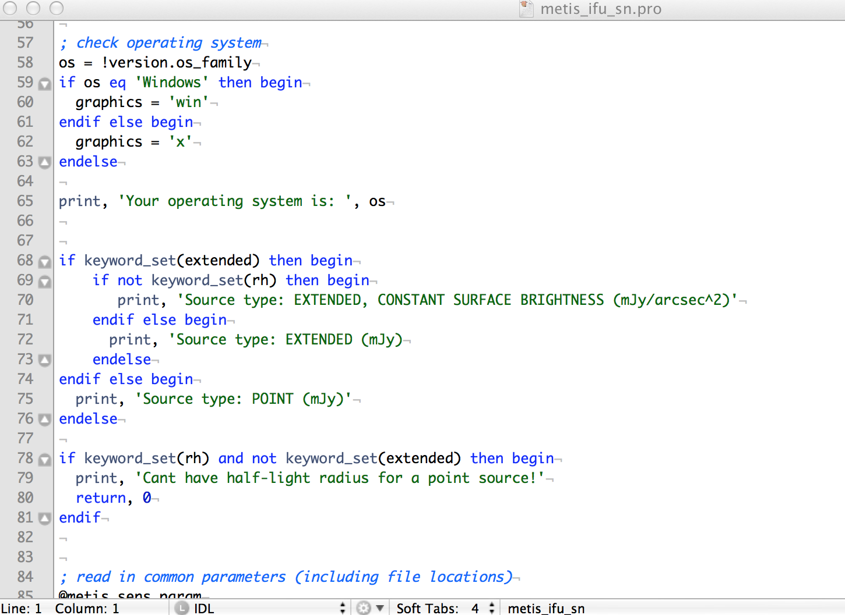
(Good) Instrument modeling:
Better instruments, Better science

Slide 16
Understand design trade-offs
Estimate / verify scientific capabilities
Determine observational strategies
Test processing and analysis procedures

Slide 17
HARMONI Simulator Scheme
HARMONI observed cube
AO PSF
Science input cube
Noise model
HARMONI design + throughput
DIT x NDIT
Atmospheric differential refraction (ADR)
Sky transmission + radiance
~10s GB!!

Slide 18
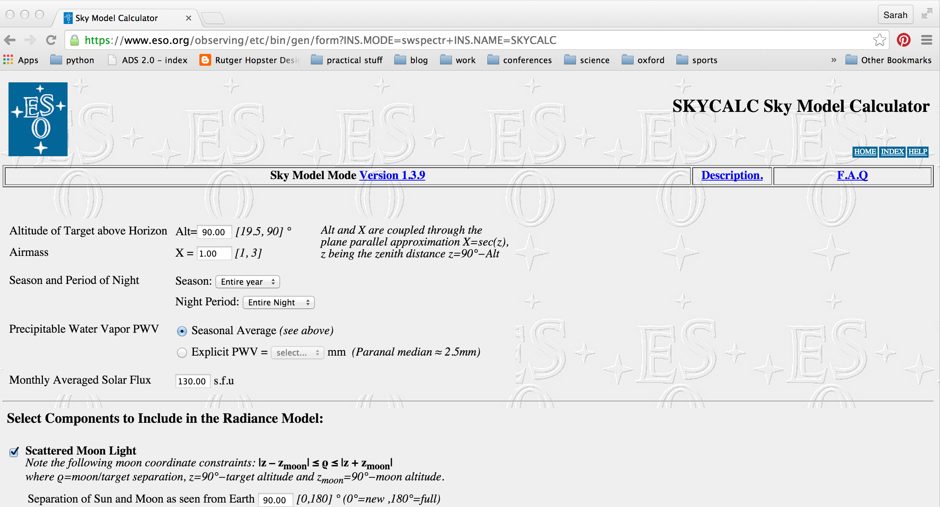
Sky background model: ESO SkyCalc
https://www.eso.org/observing/etc/bin/gen/form?INS.MODE=swspectr+INS.NAME=SKYCALC
Noll+ 2012, Jones+ 2013, Moehler+ 2014

Slide 19
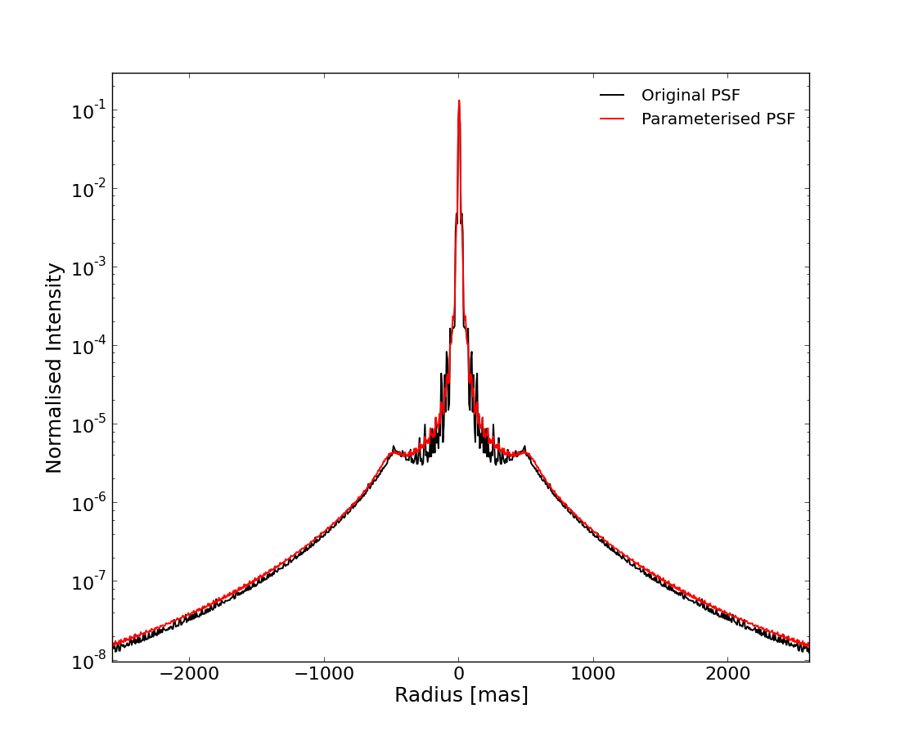
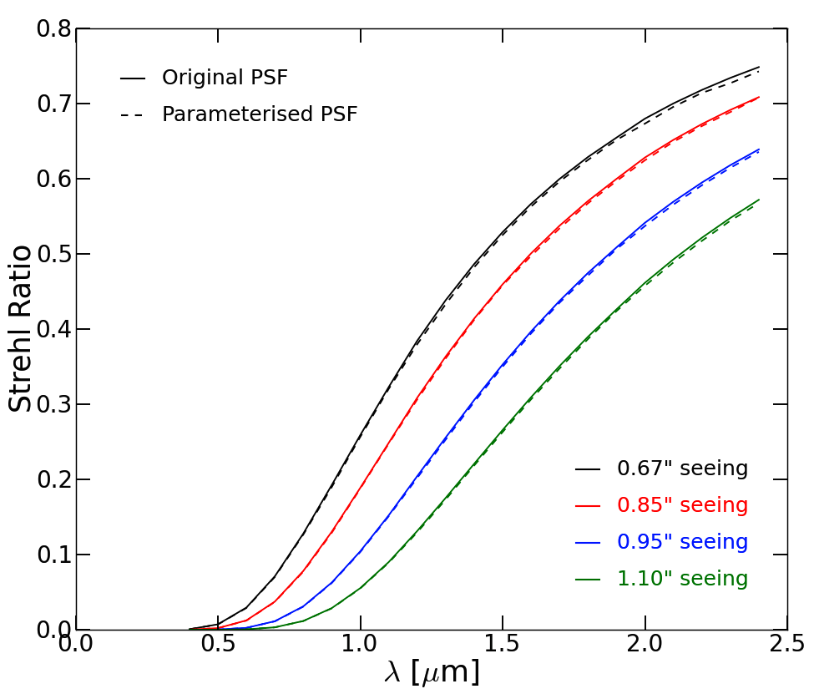
AO PSF parameterisation
Functional parameterisation
→ No fudging or interpolations
(AO simulations by Thierry Fusco)
Sharp core
Extended halo
For natural guide star, laser tomographic AO
Different seeing values
Across wavelengths
Zieleniewski et al, 2014

Slide 20
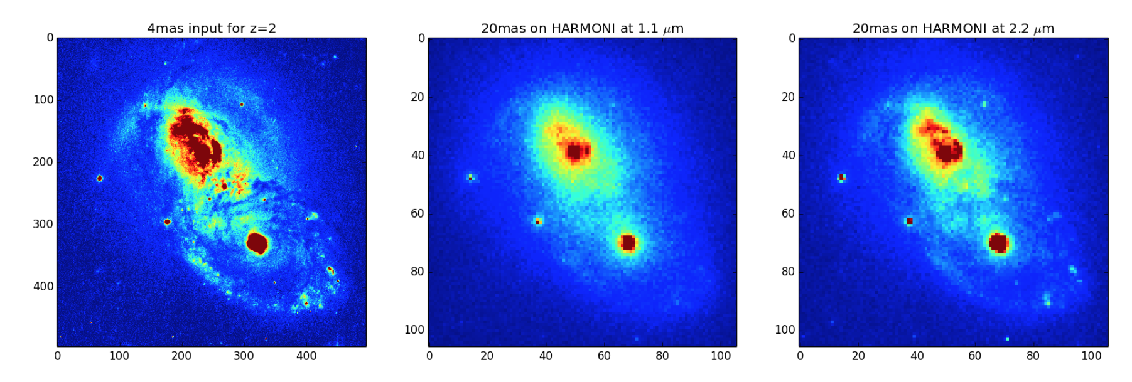
Effect of AO in the near-IR
Z = 2
4 mas input
20 mas obs
[OII] @ 1.1 µm
20 mas obs
Hα @ 2.2 µm
Simulated ULIRG @ z=2
Zieleniewski et al, in prep

Slide 21
Simulator output verification
Vs. Puech et al (2010)
Vs. SINFONI ETC
Simple model of z=2 galaxy
Zieleniewski et al, 2015

Slide 22
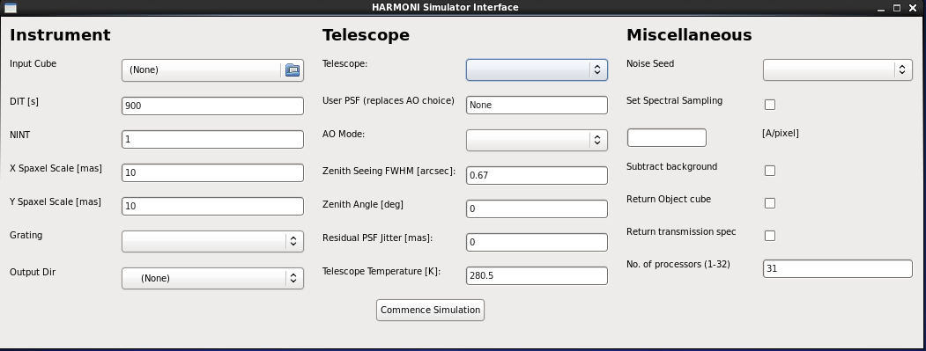
GUI or command-line
Instrument setup:
Input cube
DIT x NDIT
Spaxel scale
Grating
Telescope
PSF, AO mode
Zenith angle
Seeing
Jitter
temperature
Housekeeping
# processors to use
Outputs required
…
Publicly available from mid-2015

Slide 23
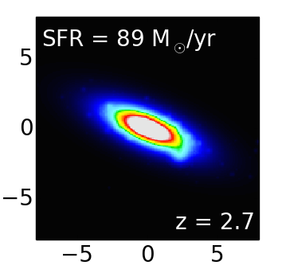
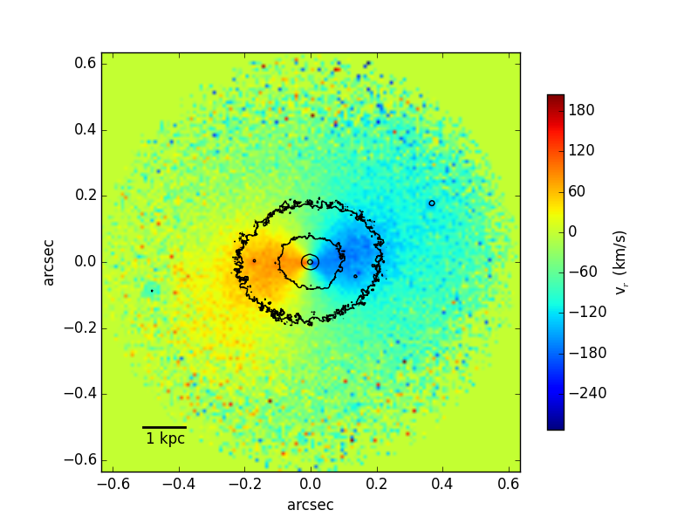
Integral field spectroscopy of high-z galaxies in the e-elt era
Simulated HARMONI observations in of galaxies in the peak star formation era
Kendrew et al, in prep
Zieleniewski et al, 2015

Slide 24
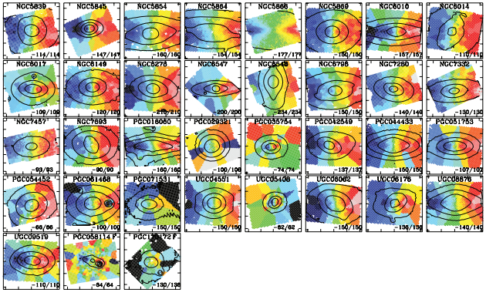
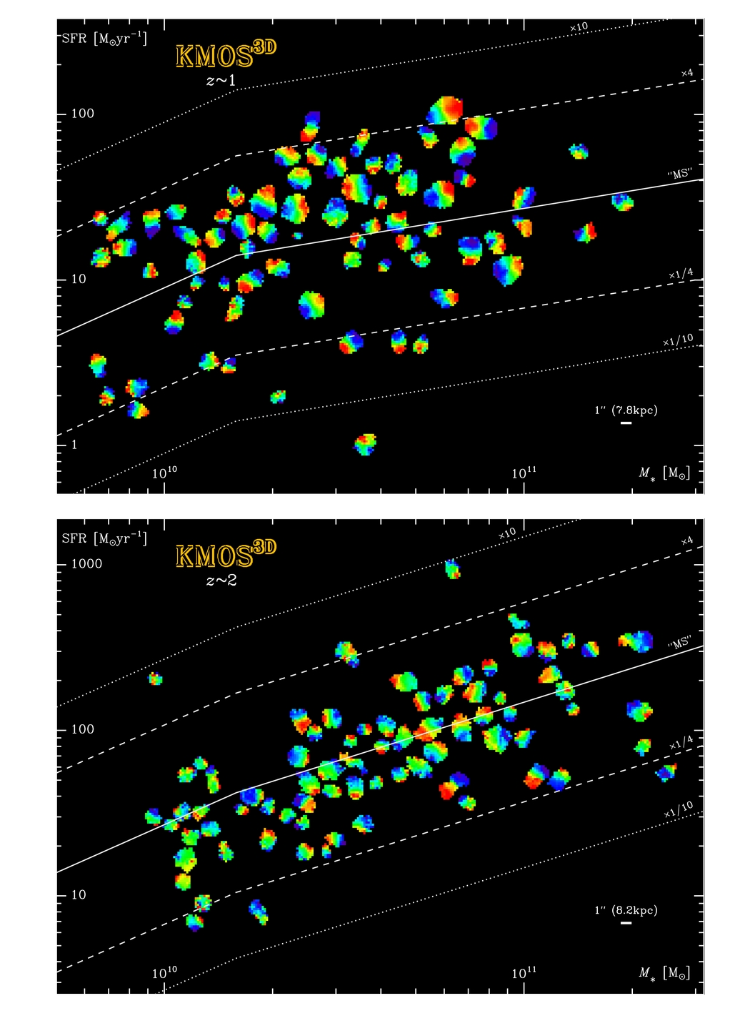
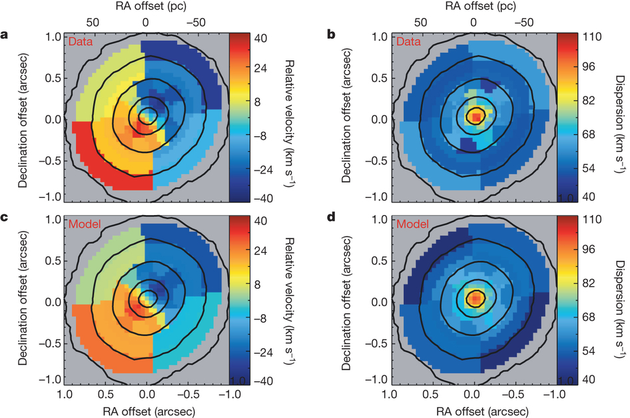
Galaxy evolution studies with IFS
Krajnovic et al 2011
How do galaxies assemble their mass over cosmic time?
Mergers or accretion?
How is the formation of stars from gas regulated as galaxies grow?
Galaxy – black hole co-evolution?
Seth+ 2014
Wisnioski et al 2014

Slide 25
Current state of the art
IFU instruments assisted with/without AO inc LGS on all major 8-10-m class telescopes (SINFONI, MUSE, KMOS, OSIRIS, NIFS…)
Excellent instruments on smaller telescopes: SAURON (WHT), PMAS (CAHA), VIRUS-P (McDonald)… + SDSS IV/MANGA!
Spatially resolved emission line spectroscopy to z~3-4
on kpc scales (e.g. Förster Schreiber+ 2006, Wisnioski+ 2014, Law+ 2009)
Absorption line IFS for stellar populations & dynamics limited to local Universe, low z
(e.g. McDermid+ 2015, Blanc+ 2013, many more)

Slide 26
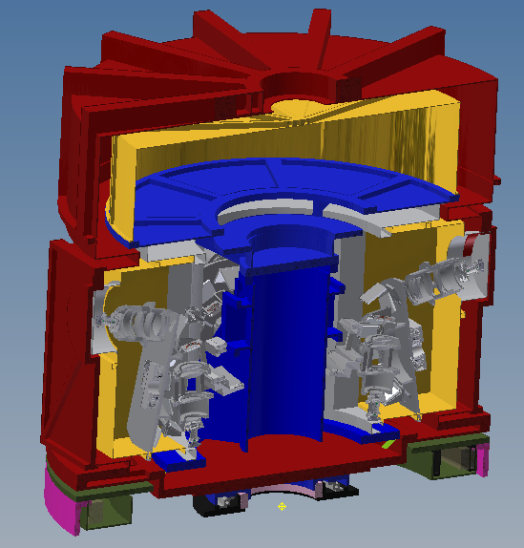
+
For galaxies at z = 2-5:
Gas kinematics on scales of ~ 100s pc
(~ giant HII regions!)
Push emission line IFS to lower SFR, M*
Study stellar kinematics, abundances in the peak star formation era

Slide 27
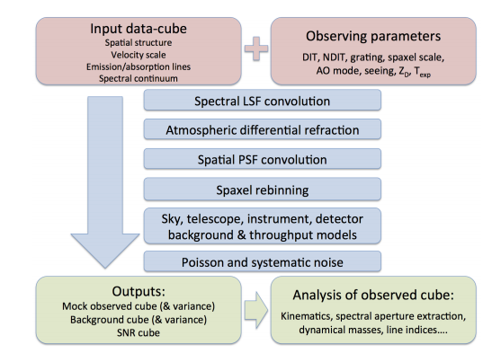
HARMONI Simulation process
Zieleniewski et al, 2015

Slide 28
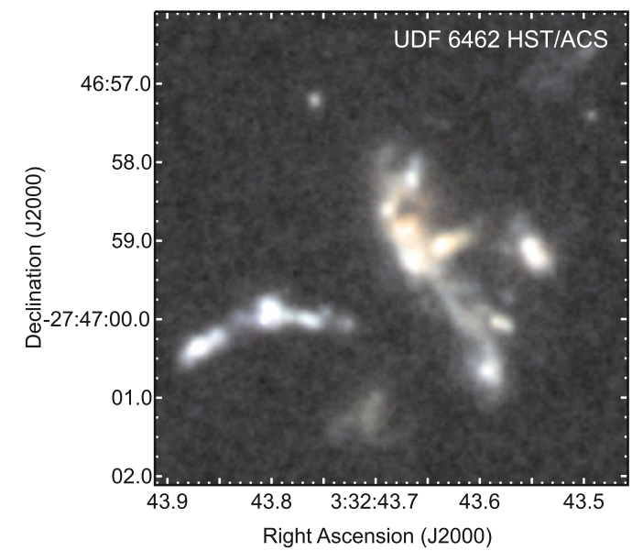
IFS of clumpy star-forming galaxies
(S. Zieleniewski & M. Swinbank)
High-z disky galaxies known to contain 10⁷-10⁹ M clumps. Thought to form through disc instability
What parameter space in z, M*, SFR can HARMONI explore at different spaxel scales with emission line IFS?
How well can rotation curves, velocity dispersion of galaxy & individual clumps be recovered?
Clump-cluster galaxy @ z= 1.6 (Bournaud+ 2008)
Notes:
Clumps are important – they’re thought to form from internal grav instabilities in gas-rich discs; they are seen to be ubiquitous in galaxies with ordered rotation. At high-z galaxies (1-5) SF galaxies are generally gassy, clumpy and turbulent. ~50% of baryons in cold molecular gas Daddi+ 2010, Tacconi+ 2010; giant SF clumps of 10^7-10^9 Msol, velocity dispersion of several 10s of km/s and SFR around 100 Msol/yr.

Slide 29
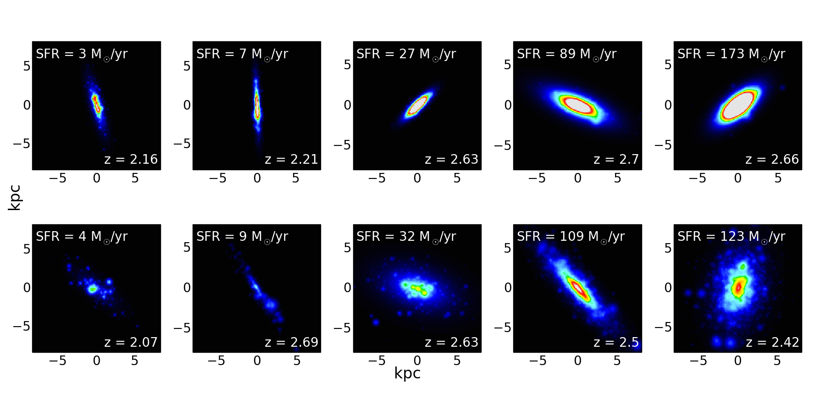
Simulated clumpy galaxies
25 simulated galaxy spectral cubes at z=2-3, randomised in:
  Sersic index
  Viewing angle
  Redshift
  M*
  Gas fraction
  Clumpiness
  A_{V}
Clump luminosity function matches that seen in observations (e.g. Livermore+ 2012)
Spectra physically motivated (continuum + emission)
Assumes constant uniform SFR over the age of the Universe at the given z
Assumes fixed nebular line ratios, Z

Slide 30
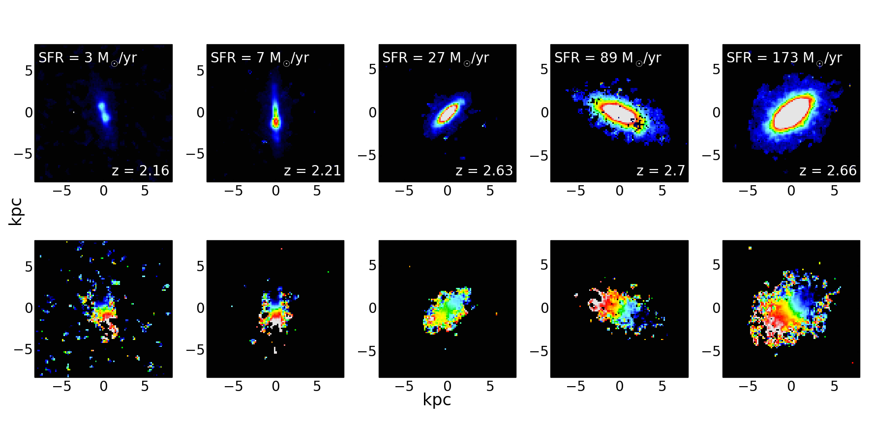
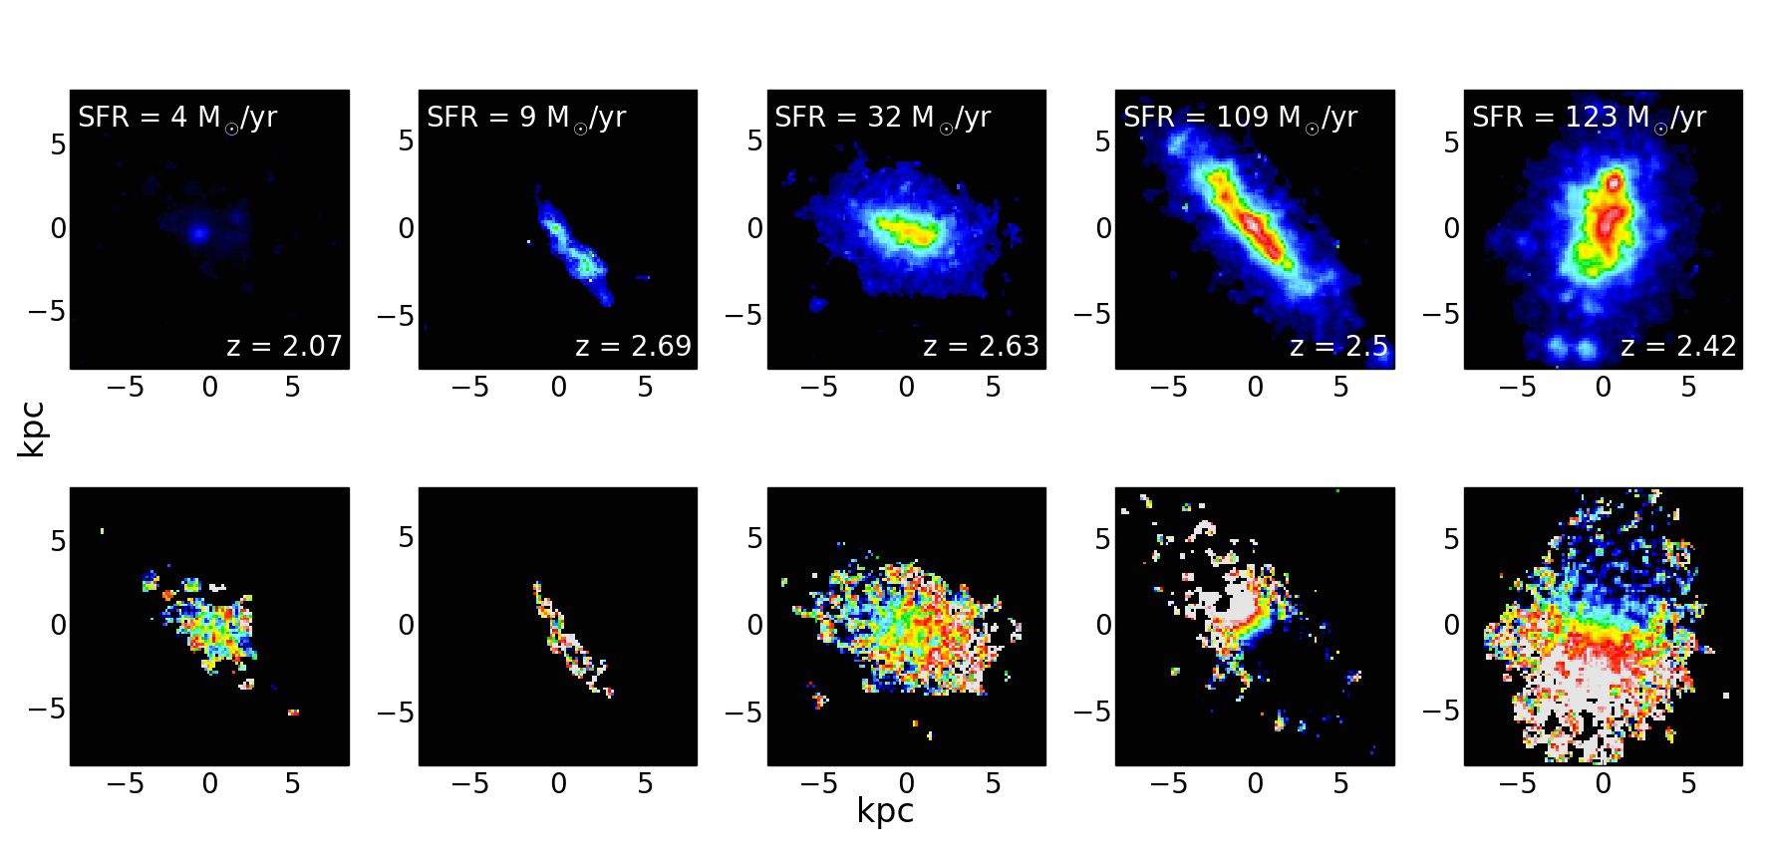
Simulated observations:
900s x 40 = 10 hrs
LTAO
20 x 20 mas spaxel scale
R ~ 3500
DATA ANALYSIS
“Standard” processing
Kinematics measured from Hα
SMOOTH
CLUMPY
Zieleniewski et al, 2015

Slide 31
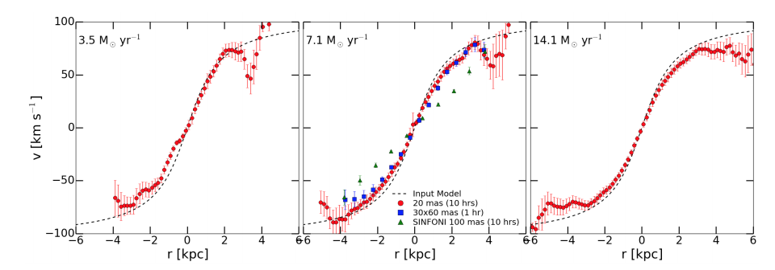
Dynamical mass derived:
VLT-SINFONI: 4 x 10⁹ M_{sol}
E-ELT-HARMONI: 9 x 10⁹ M_{sol}
Input mass = 8.6 x 10⁹ M_{sol}
E-ELT HARMONI: 5 x more independent data points
Zieleniewski et al, 2015

Slide 32
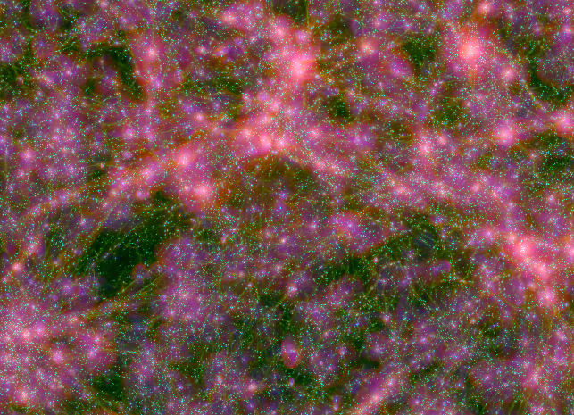
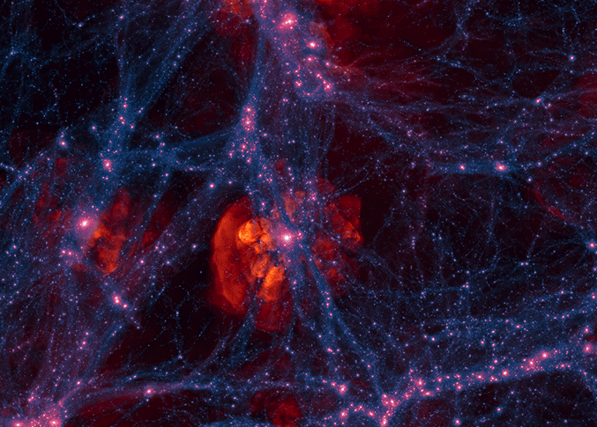
Simulating better galaxies
(SK & J. Devriendt; Kendrew+ in prep)
Cosmological simulations now have spatial resolutions suitable for making observational predictions
Provide >> 10⁵ galaxies, evolved over time, with precisely known input physics
Major simulations (Horizon-AGN, Illustris, Eagle) routinely producing mock observations but mostly images & integrated spectra (e.g. Torrey+ 2014)
For HARMONI
Input spectral CUBES from simulation particle data
Mock IFS observations with Simulator
Horizon-AGN
Illustris

Slide 33
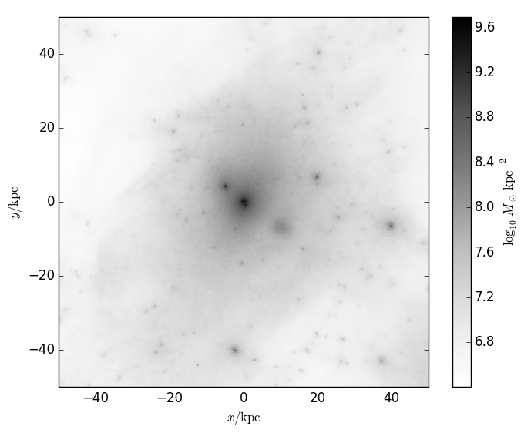
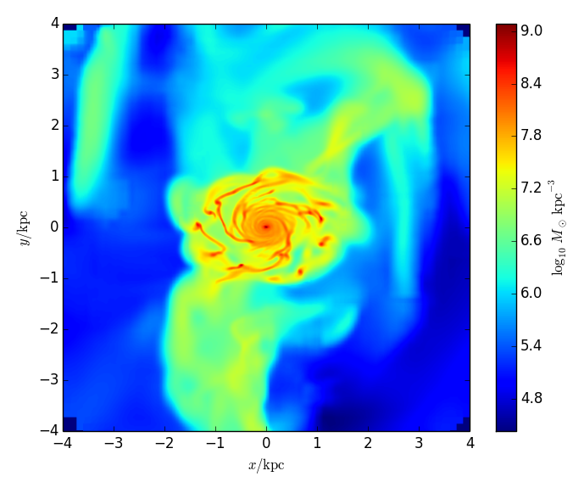
NUTFB simulation@ z=3
M_{DM} = 5e4 M
M_{star} = 2e4 M
nth = 400 cm⁻³
z_{end} = 3
z_{UV} = 8.5
SFE = 1%
SN Type II feedback
Zoom-in sim from the NUT suite (Powell+ 2011; Kimm + 2011) using RAMSES (Teyssier 02)
Terminates @ z=3 (@ ~2.2 Gyr), physical spatial resolution of 12 pc
“Milky Way-like galaxy”

Slide 34
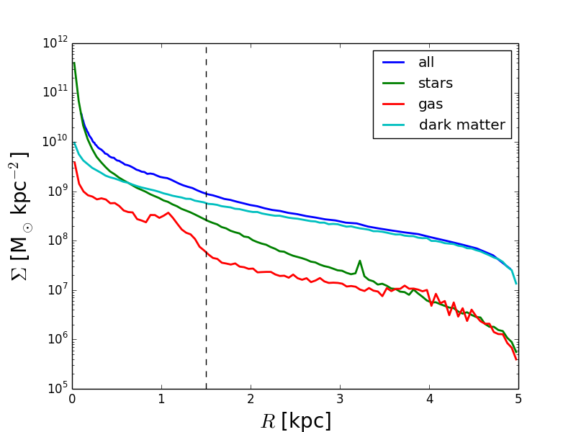
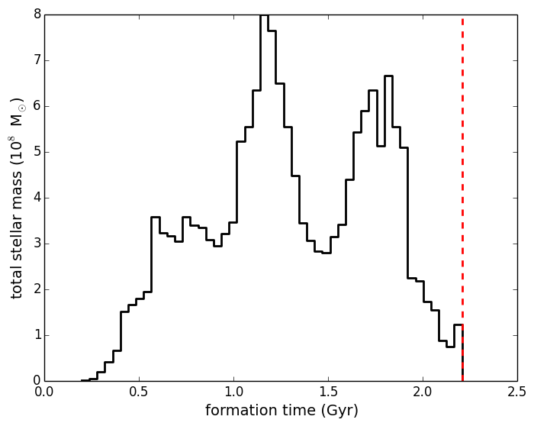
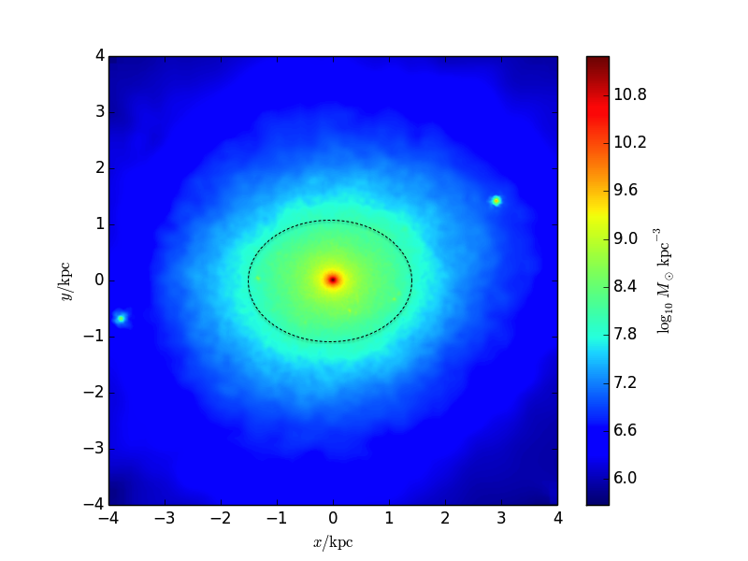
Mass density profile →
Halo mass 10¹¹ M, Stellar mass 10¹⁰ M
Behroozi+ 2013
^ Star particle age distribution ^
← Metallicity distribution
^ Stellar mass density ^

Slide 35
Every star particle represents a simple stellar population (SSP)
Star particle (SSP) spectrum
Mass
Metallicity
Age
[x, y, z] velocity (rest-frame)
Library of model spectra

Slide 36

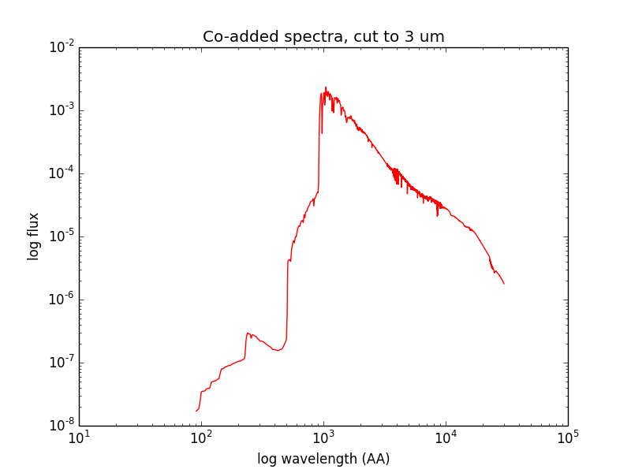
SSP
SSP
SSP
“Pseudo-spaxel” spectrum
1 mas x 1 mas grid of “pseudo-spaxels”
BUT NO GAS!
MIUSCAT SSP models (Vazdekis+ 2010)
Salpeter IMF
Empirical library
3800 – 9500 Å
FWHM ~ 2.5 Å (R~1500-2500)

Slide 37
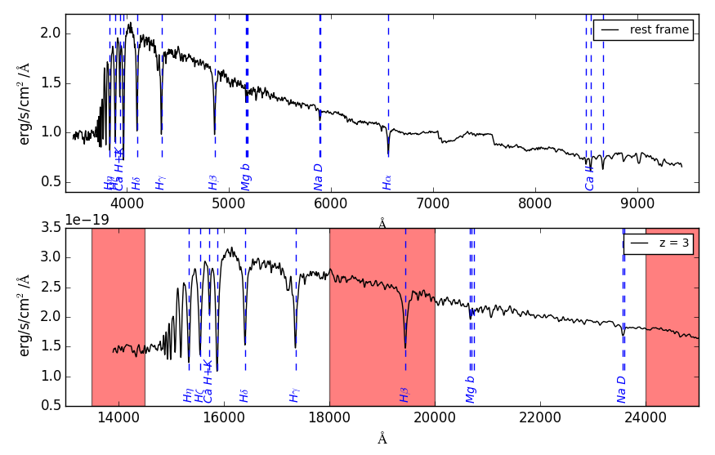
No “simple” extrapolation to high z
No continuous wavelength coverage in NIR
H lines not usable in absorption for star forming galaxies/AGN
Absorption features weaker from young stellar population
H
K
Ca H+K
Mg b

Slide 38
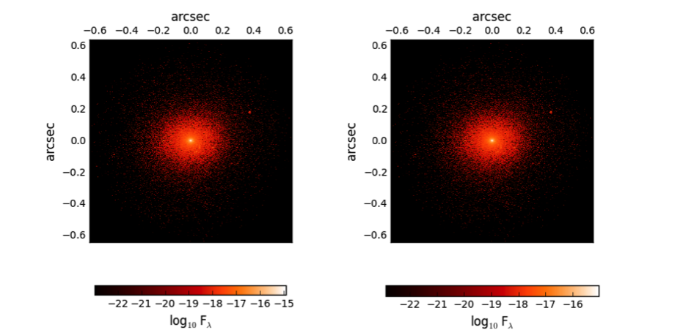
H band
Ca H+K
K band
Mgb
Kinematics from Penalised Pixel fitting (pPXF)
(Cappellari & Emsellem, 2004; http://www-astro.physics.ox.ac.uk/~mxc/software/)
v_{LOS} = - 48 ± 12 km/s
σ* = 180 ± 16 km/s

Slide 39
Spatially resolved kinematics
Every spaxel can be fit!

Slide 40
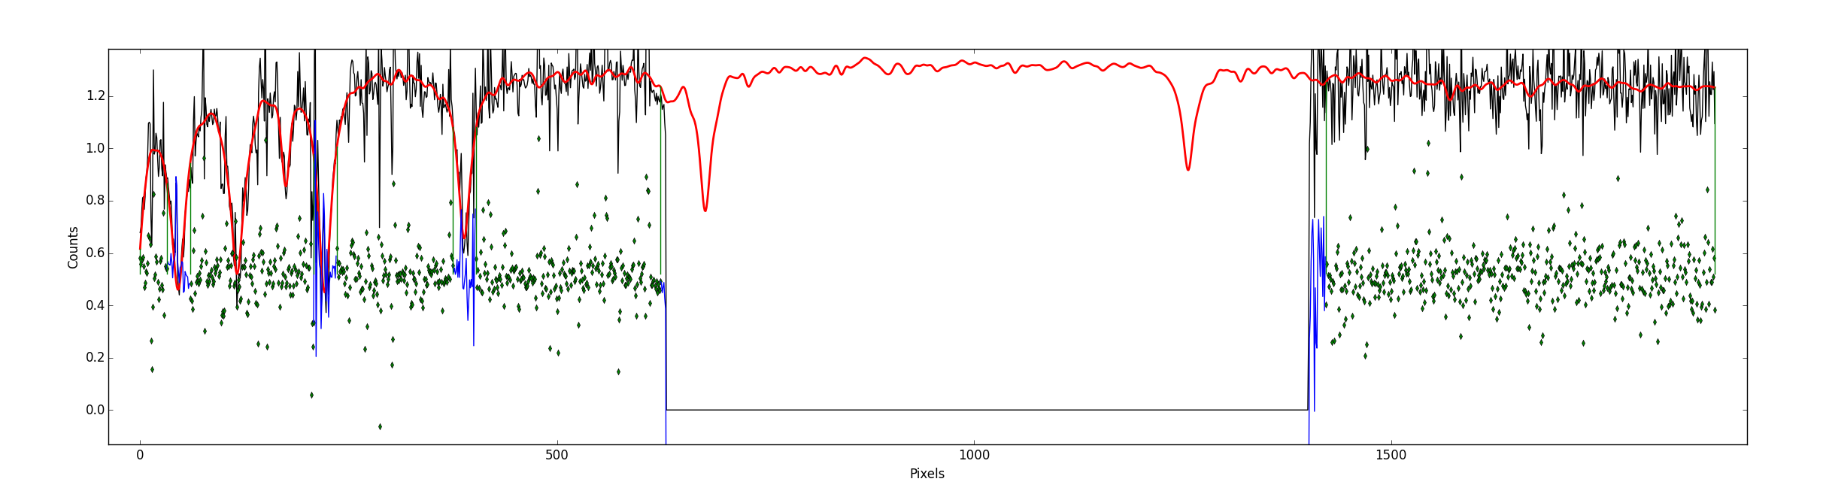
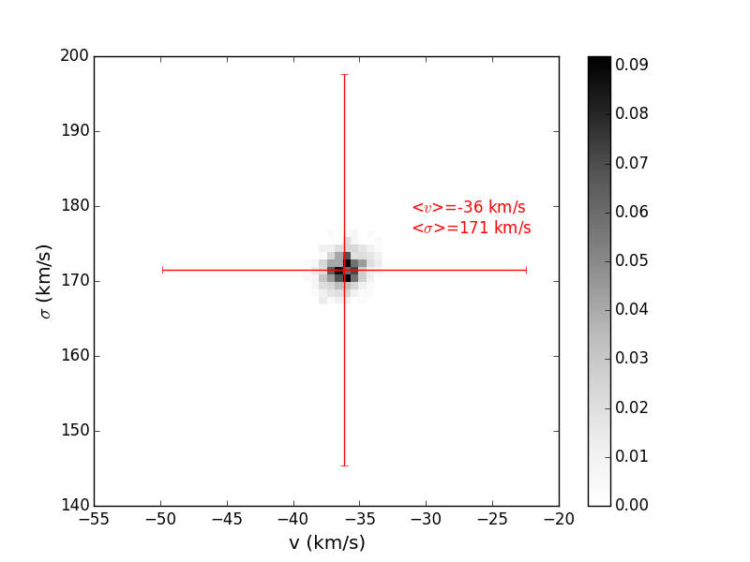

Integrated velocity + dispersion
Optimally extracted integrated spectrum of galaxy
(inverse variance-weighted)
pPXF fitting with abs lines & gap masked out for fit
Different weighting and extraction region compared with input spectrum – needs more work…

Slide 41
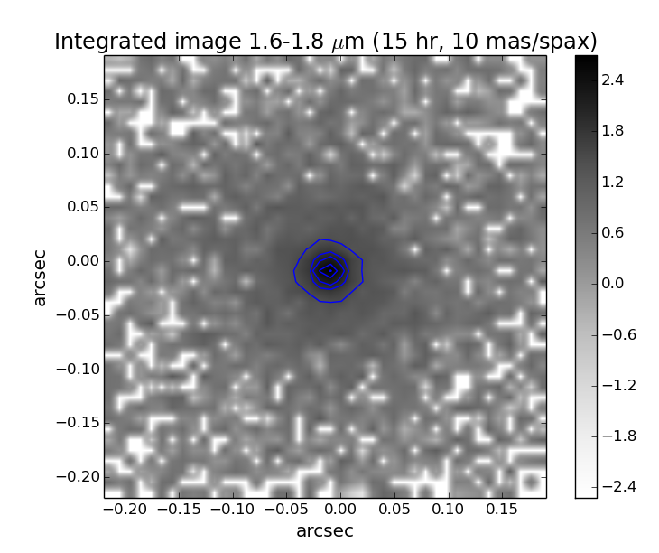
15-hour observation with HSIM
900 s DIT x 60
Median seeing
LTAO
10 mas spatial sampling
Runs with PSF convolution switched off

Slide 42
Analysis options
Integrated spectroscopy
Noiseless output
→ capabilities in the high-SNR limit + systematics
Noisy output
→ pushing the limits at low-SNR

Slide 43
Integrated spectral fits (inner 3 kpc)
v_{LOS} = -48 ±12 km/s
σ* = 180 ± 16 km/s
v_{LOS} = -42 ±15 km/s
σ* = 181 ± 12 km/s

Slide 44
Spatially resolved kinematics
Input vs. High SNR without PSF convolution to validate methods

Slide 45
No PSF convolution
PSF convolution
Difference
Davies et al 2011
Davies et al (2011) propose different correction methods for seeing limited observations
Can extend this to E-ELT AO observations for high & low SNR data

Slide 46
Summary: Questions & Opportunities
Single galaxy simulations:
  Identify best wavelength regimes vs. redshift
  Test observability of different physical prescriptions used in simulations
  Test observational systematics for e.g. kinematics analysis
Thousands of galaxies:
  Explore parameter space for next-generation observatories
  With good instrument simulators, can define sample selection criteria across telescopes/instruments
  Big data & coding problem
High resolution simulations
+
Good instrument simulators
=
Better science!

